Slide 1
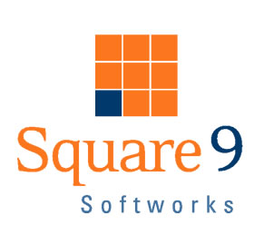
The How to Guide for Selling EDM in Focused Applications

Slide 2
Objective
Challenge when selling EDM - Sales Representative is expected to understand an array of industry specific applications.
This training program is designed to put focus on three very common applications where SmartSearch is used effectively.
Collectively these four practice areas comprise more than 60% of the current base of SmartSearch installations.
The objective of this training is to empower you with the tools that allow you hunt for opportunities with focus

Slide 3
When to Sell SmartSearch?
You sell copiers and need a simple, cost effective means for managing paper through your equipment.
90% of the time just a simple scan, index and retrieve process is needed
Need ability to interface with any copier, as you’re not always the incumbent
Value priced to ensure your competitive equipment deal is not side tracked
When the required features are?
When capture from any brand copier
When out of the box integration capabilities with line of business systems
When a turnkey solution requiring no 3rd party applications
When automated data entry tools
When retention scheduling, matching and exception reporting
When document version control and check-in/out capabilities

Slide 4
Prospect Questionnaire
General Information
Company Name
Main Contact Name
Email
Phone
Company Industry (i.e. healthcare, distribution)
Size of company (# of employees)
Infrastructure
Number of MFP’s
Number of desktop scanners
How many geographically distributed offices?
Business Process (repeat for each process or department)
Name of department (i.e. HR, accounting)
Total number of staff in the department?
Total number of users that may access SmartSearch concurrently?
Total number of documents processed per month?
Type of documents to be captured? (i.e. invoice)
Are there any paper based forms (i.e. application, new account)?
If so, how many types of paper based forms?
What is name of current line of business system (i.e. SAP)?
Are there any compliance mandates SmartSearch must meet?
If so, what specific compliance mandates?
If you could improve one process what would it be?
Why?
What’s your biggest pain point right now related to paper or content?

Slide 5
Call Script
Talk tracks used to get your point across while educating the prospect on your business and what solutions you can offer
Do you have any paper based processes you would like to eliminate?
Do you have any current paperless office initiatives for the coming year?
Do you pay to store documents offsite?
Would you be open to exploring options for a paperless office or department?
“We help companies with paperless office solutions that allow for document compliance, streamlining the payment process while reducing costs through digital document capture and advanced scanning.”
“We have worked with hundreds of clients of all sizes to help them reduce the time and costs associated with paper-based and document image-based filing and archiving systems.”
“We offer a number of software tools that can simplify the scanning process.”
“Our systems allow you to organize any type of document, set security for each user, and allow retrieval from anywhere at anytime”

Slide 6
Targeted Applications
AP Invoice Automation
Objective: Automate the classification, separation and extraction of data from AP invoices to drive approvals, vouchering and posting.
  Automate indexing and posting of AP invoices to SmartSearch and AP system
  Automate the matching of Purchase Orders to Invoices
  Automate the approval routing and notification of AP invoices
  Reduce your AP processing costs by 75% or more
  Handle increased business without additional headcount
Proof of Delivery
Objective: Reduce reliance on legacy, high impact printers and automate the proof of delivery document storage and matching process
  Reduce reliance on legacy high impact printers
  Provide validation and exception reports for proof of delivery tracking
  Provide customer service instant access of delivery documents
  Provide professionally looking invoices with better accuracy capture using barcodes
  Generate transpromotional variable messaging

Slide 7
Targeted Applications
3rd Party Medical Billing
Objective: Streamline the patient billing process by electronically capturing, storing, annotating and retrieving pertinent patient documentation for healthcare clients.
  Make paper-based EOB’s (explanation of benefits), super bills and patient claims (HCFA 1500, UB-04) text searchable PDF, allowing content searching
  Provide advanced annotation support
  Meet HIPAA compliance and HIT regulations
  Provide secure, encrypted web portal interface
  Provide retention scheduling to ensure proper records management protocols
Human Resources Management
Objective: Streamline recruiting and employee onboarding, initiate automated review and approvals, increase compliance
  Store resumes in a content searchable repository to easily find candidates by keyword
  Turn employee onboarding paper forms into electronic web forms
  Automate annual reviews by triggering email reminders and automatically staging review forms
  Route PTO requests and expense forms through approval hierarchies
  Meet and maintain FMLA and OSHA compliance requirements

Slide 8
Distribution and Manufacturing – The AR Invoice Process
Introduction
Managing the pick ticket, packing list, bill of lading (BOL), and AR invoice, which are all synonymous with the same document and process.
The paper process associated with distribution is the same industry wide.
The Process
Pre-printed, multi-part forms are printed on high impact, legacy printers
One copy is filed
Two copies are separated and manually handed to drivers
The delivery is made, changes recorded
One copy is left with the customer
One copy with signature is returned
This validation process is extremely labor intensive:
Sorting based on customer name
Manual reconciliation of order upon return delivery
Manual filing of document in cabinet

Slide 9
Distribution and Manufacturing – The AR Invoice Process
Square 9 provides three basic options, all with varying price points.
Each option includes a basic SmartSearch document management repository that while used to store invoices, can be extended to support other critical paper based processes such as human resources, contracts, sales orders, correspondence and virtually any other electronic, multi-media or paper content.
Questions to Ask?
Business Process - Distribution
Number of invoices generated per day?
How many parts on the form?
Approx. cost per form or box? (i.e. 3 part typically $0.12)
Number of high impact printers?
Does current invoice have a barcode?
Does each form part need to be colored?
Does customer get a copy of the invoice at delivery?
Are deliveries made by internal or 3rd party?
Is tracking proof of deliveries a current problem?

Slide 10

Option #1: Add Barcode to NCR Pre-printed Forms
Advantages: Least expensive option. Can be implemented rapidly.
Disadvantages:
Must validate against external database or file.
Natively cannot perform a page level verify without external data.
Less accurate automation - Barcode recognition on dot matrix NCR paper vs. laser provides less quality image to read and interpret.
Still must pre-print forms and waste forms if change is made to physical form.
Requires expensive VRS image enhancement software and a dedicated desktop scanner.
Must have AS/400 programmer add barcode
Must have enough space on the physical form
Approximate range cost: $6,000 - $8,500*

Slide 11
Option #2: Variable Print Distribution
This option offers the most accurate, streamlined process for tracking and capturing
Requires switching from high impact to laser printers
No need for image enhancement technology, or a dedicated desktop scanner
Advantages:
100% automated – data entry and page level verification
Reduce need for pre-printed forms
Reduce need for external database output for validation
Move printing to more cost effective laser printers
Delivery exception reporting capability
Automated inbound data entry of revised delivery ticket
Automated storage of outbound delivery ticket in SmartSearch
Distribute documents automatically through sophisticated workflow's to fax or email
Turn invoice processing into advertising opportunities
Easily add smart features to your documents including barcodes and charts
Disadvantages:
Radical process change from high impact to laser
Upfront hardware costs to print laser
Increased consumables at ~ $0.08 - $0.10 per page for carbonless paper, MFP clicks and staples (assumes 3 part form).

Slide 12
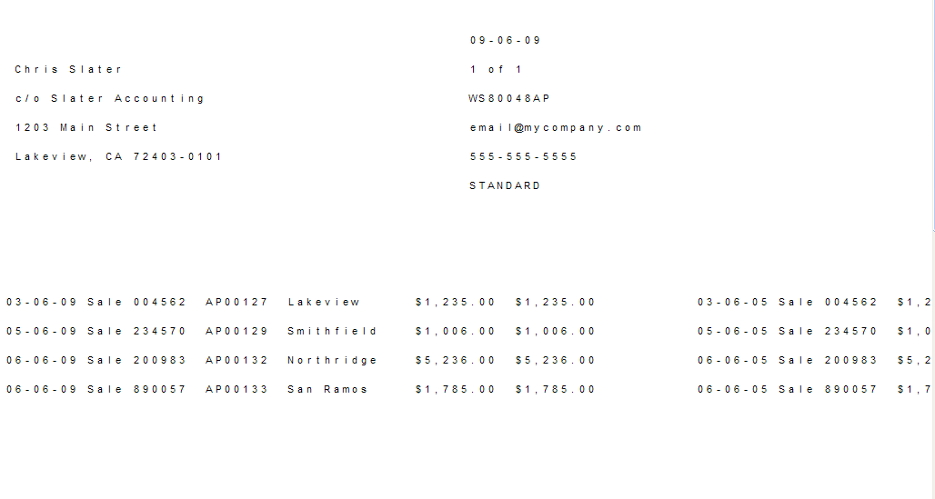
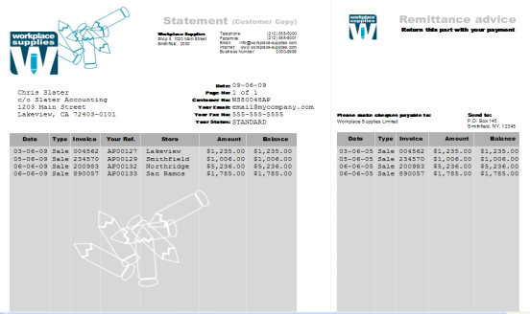
Option #2: Variable Print Distribution
Approximate range of cost: $14,000 - $20,000*
Office Equipment Dealer Benefits
Sell MFP’s as a byproduct, replacing high impact printers with your equipment
Typically production class machines, some color are required. Larger sale, heavier volume.
Driving significant amount of clicks to your devices
Need for copier finishers and consumables such as: carbonless paper, staples and larger service contracts
What to look for?
High impact printers, AS/400 or mainframe computers
Pre-printed, multi-part forms and NCR paper
Non-validated processes. (i.e. Need to match proof of delivery to original invoice, barcoding)
Boxes, bins, cabinets or shelves of multi-color paper

Slide 13
Option #3: Zone OCR of NCR forms
This is the most common approach and also the most expensive.
Does not require any process change
Advantages:
No changes required to current process and no 3rd party changes to forms
Faster print and finishing on NCR versus variable print and finishing
Disadvantages:
The most expensive option
Requires a desktop scanner running Kofax VRS Professional.
Must validate against external database or file.
Natively cannot perform a page level verify without external data.
Least accurate of the solutions with best outcome of 90% automation
Qualifying Metrics
If order to print and pack process is less than 3 hours, this is the best approach
If culture prefers NCR paper and not comfortable changing the drivers behavior
If significant existing backlog of pre-printed forms exist
AR Invoice Number
Date
Customer Name

Slide 14
Option #3: Zone OCR of NCR forms
Option A includes 1 concurrent capture license of Kofax Capture and a 300,000 ppy (pages per year) volume license, Xerox 742 scanner with VRS Professional plus services and support
Option B includes 1 named scan licenses of Kodak Capture Pro (class B license), unlimited scanning, and Fujitsu fi-6140 scanner with VRS Professional, 1 data merge plus services and support.
Option A: Approximate cost: $20,000 - $25,000*
Option B: Approximate cost: $13,000 - $15,000*
AR Invoice Number
Date
Customer Name

Slide 15
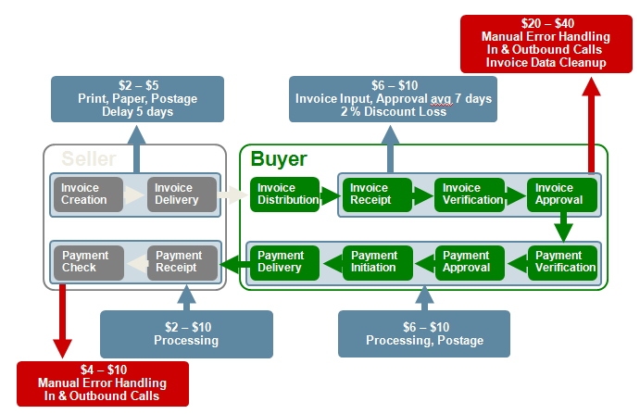
Accounts Payable – AP Invoice Automation
The seller to buyer, buyer to seller relationship is a costly one.
This process is traditionally very manual and can cost in upwards of $85 per order to process.
“What would it mean to your accounting operations to simply compile a batch of paper invoices, place them onto the scanner and have a technology intelligently extract data, line items, send for approval and once approved feed your Accounting system?”

Slide 16
Accounts Payable – AP Invoice Automation
The world of accounting is driven primarily from unstructured paper
Each and every vendor creates their own documents
As a result, it is impossible to automate processing of purchase and pay type documents using conventional technologies.
That is where unstructured data capture is most useful, providing immediate hard cost reduction and superior automation rates.
Questions to Ask?
Business Process – AP Invoices
What is the volume of paper invoices processed per month?
What is the avg. number of pages per invoice?
How many Full Time Equivalent AP clerks (FTE's) perform the manual tasks of sorting and keying-in data from invoices?
How many hours each day on the average does a clerk spend manually keying invoices?
What is the name of the accounting software?
Do you manually match PO to invoice?

Slide 17
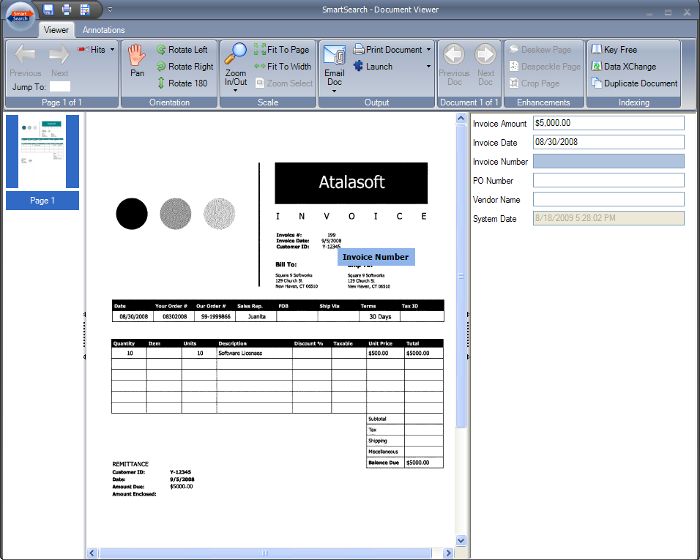
Option #1: Basic Document Management
To satisfy smaller companies, low volume invoice document processing
Smart technologies to aid in more streamlined paper processing.
SmartSearch Data XChange and Key Free Indexing
Advantages:
Least costly solution offering ad-hoc capture of purchase orders, pick tickets and invoices with basic 3 three way match.
Add Work XChange for automated invoice approvals and PO matching.
Use Key Free Indexing to index unstructured invoices.
Disadvantages:
No automation - all manual data entry.
No native release to AP system must be custom developed.
Approximate Cost: $4,000 - $15,000*
Qualifying Metrics
This solution is the base system for all options below
Volume of invoices is less than 1,000 per month
Computer generated documents, not handwritten
Vendor invoices wide ranging in terms of layout

Slide 18
Option #2: Unstructured Capture Automation
Message: Revolutionize the way you do business. Turn dumb payable documents into valuable business data points.
Advantages:
Up to 90% AP invoice and PO matching automation.
Reduce headcount by 75%, hard costs associated with labor, benefits and taxes.
Direct data integration of invoice header and line items into payables system.
Automated page separation and auto document classification.
Disadvantages: Most costly solution.
Approximate Cost: $50,000 - $200,000
Qualifying Metrics
Company processes more than 10,000 invoice pages per month
Company employs more than 4 full time AP clerks
Company receives vendor invoices from more than 100 different vendors
Company receives computer generated (not handwritten) invoices

Slide 19
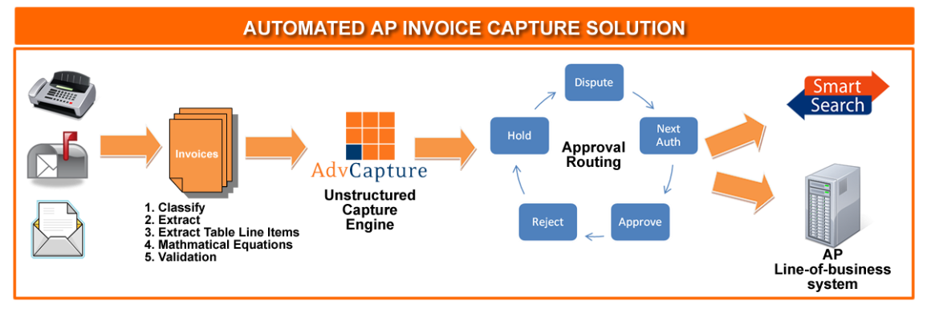
Option #2: Unstructured Capture Automation
Why do I want to automate payables?
Reduce hard labor cost associated with AP staff
Replace low value data entry with high value invoice troubleshooting & analysis
Balancing peak and slow times – eliminating temporary staff needs
Reduce double data entry
Vendors penalties for late payments
Early pay discounts
  Consider a typical discount of 2/10 NET 30 (2% discount if the invoice is paid within 10 days)
  If the savings are amortized over a 20-day period each year, the result is a 36% return.

Slide 20
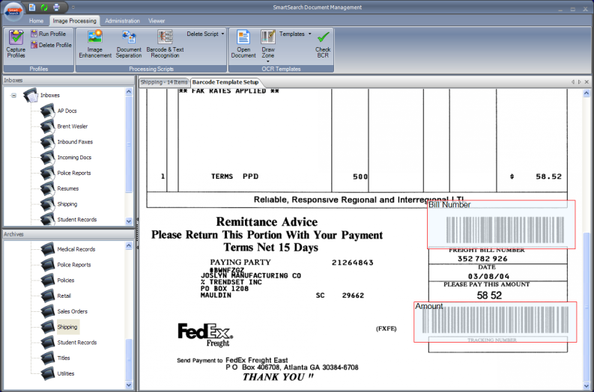
Option #3: Structured Capture
Advantages:
Semi-automated solution, with addressing of major vendor supplier invoices versus one size fits all.
Less costly than complete unstructured capture solution.
Reduce overall labor by 20-40%.
Disadvantages:
Low accuracy and automation resulting in additional validation.
No line item data extraction.
No auto classification.
Zone OCR regions must have enough white space around the text.
Must use a desktop scanner and Kofax VRS 3rd party software to receive better OCR results.
Not a good candidate for MFP capture.
Approximate cost: $15,000 - $80,000
Qualifying Metrics
This solution option only works if the documents are structured
80/20 rule where 80% of business is generated from 20% of the vendors.
Process low volumes of structured documents – less than 2,000 pages per month
Line item data extraction is not necessary

Slide 21
Healthcare - Third Party Medical Billing
Introduction
Since there are thousands of insurance carriers, the task of standardizing the transport and format of EOB’s and medical claims is unrealistic.
Since 3rd party medical billers are primarily outsourced AP clerks, SmartSearch does not have to compete with EMR (electronic medical records) systems.
Most of the billing is still done on paper since the third party is not the originating healthcare organization.
These third party billers typically employ large amounts of data entry clerks to adjudicate (code) both the claims and resulting benefits.

Slide 22
Healthcare - Third Party Medical Billing
Healthcare clients now assume since the EMR provides the ability to attach a TIFF file, it can handle all their document management needs.
EMR does NOT address other non clinical documents
When you utilize a centralized content repository approach, all aspects of your business can participate in the management of documents.
Questions to Ask
Business Process – Medical Billing
How many claims do you process per month?
How much time is spent per document to file into a cabinet or DMS?
How many FTE data entry personnel do you employ to handle data entry and capture?
Is the number of FTE’s sufficient to keep up with demand?
What is the current error rate?
Is there adjudication software that requires entry?
If so, is double data entry performed?
Is there an approval associated with the business process?
If healthcare, what percentage of EOB’s are submitted in paper form?
How many insurance carriers do you deal with?
What percentages of documents are received via fax, mail, EDI, etc.?
How are denials handled today?

Slide 23
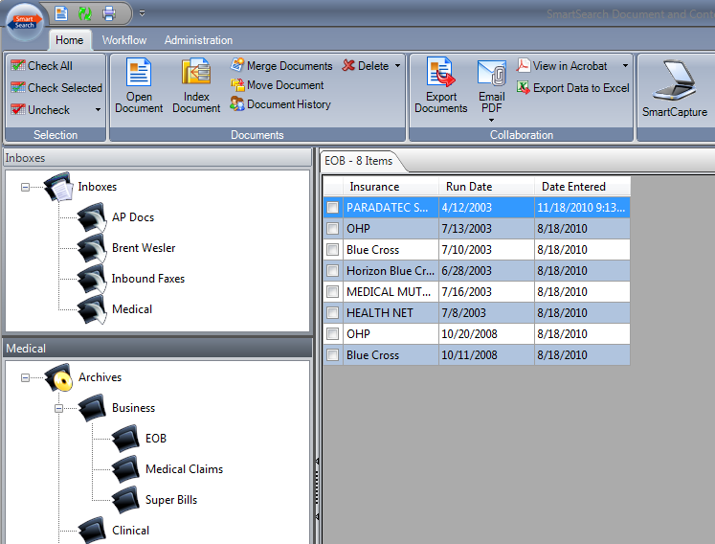
Option #1: Base Document Management
Competition against EMR and enterprise EDM systems is fierce; Square 9 has instructed resellers to focus on the third party medical billing environments.
Trends: Healthcare facilities are outsourcing the patient billing process due to cost and complexity.
This allows SmartSearch to skip the EMR integration and cannibalization “debate”
The SmartSearch price point, support for non-proprietary storage, audit trail and export capability allow us to monopolize within medical billing organizations.

Slide 24
Option #1: Base Document Management
Advantages:
Low cost to start capturing and managing paper - electronic medical claims and bills.
Ability to annotate documents, export captured documents to clients or other third parties.
Ability to convert incoming scanned images into text searchable PDF/A files.
Ability to content search records without lengthy and costly data entry operations.
Audit trail to support HIPAA compliance
Disadvantages:
All manual with very little automation capabilities.
No automated posting to adjudication system.
Approximate Cost: $7,000 - $15,000*
Qualifying Metrics
This option is the base solution and required for all available options
If majority of billing documents are handwritten
If billing company manages less than 100 clients
If billing company manages smaller healthcare practices
If the capital cost of ~$60,000 and above is not viable expense for unstructured automation

Slide 25
Option #2: Unstructured Patient Billing Automation
“What would it mean to your medical billing practice to place a set of EOB’s or other healthcare documents on a scanner and have a technology automatically classify and extract data as well as transmit the extracted data to your patient billing system?”
The Process
Our solutions work with scanned images, emails, faxes or any variety of medical forms
The process begins with a high-speed full-page OCR scan of each image.
Our solution will search every word of every document and discover the content much as a human would.
Documents are automatically sorted without the need for separator sheets
Our solution comes with pre-defined knowledgebase to reduce implementation times
Data can then be saved in x12 835 EDI format for transfer to adjudication systems
Documents and data can be automatically indexed into SmartSearch

Slide 26
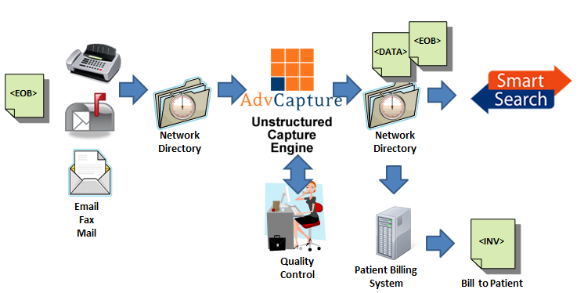
Option #2: Unstructured Patient Billing Automation
Advantages:
Data automation rates in excess of 80% across all insurance company layouts.
Eliminate the majority of manual data entry work
Seamless interface into document imaging system and adjudication systems.
Exception reports showing denials, credits, etc. Up to 75% on labor and processing savings.
Disadvantages: Most expensive solution.
Approximate Cost: $60,000 - $500,000 or more*
Qualifying Metrics
Must be processing in excess of 2M pages per year or roughly 150,000 pages per month
Must employ more than 10 data entry clerks
Majority of client billing is done on paper or electronic files NOT EDI
Unlikely good fit for anesthesia billing due to handwriting requirements

Slide 27
Human Resource Management
Questions to Ask
How many open positions are you recruiting for at any given time?
Have you ever missed out on a high quality candidate because you weren’t able to quickly mine resume data?
Is new employee production impacted by slow onboarding cycle times?
Are employee reviews difficult to manage and often significantly delayed or missed?
What is the average cycle time for document approvals?
Do decision makers have visibility into approval processes to see exactly where each document is?
Could you benefit from automated time based approval escalations?
How long does it take to produce an HR file when requested by employees?
Has document retrieval and auditing ever impacted HR litigation?
Have you ever faced fines and penalties from FMLA and OSHA?
Are your HR records protected from disasters such as a fire or flood?

Slide 28
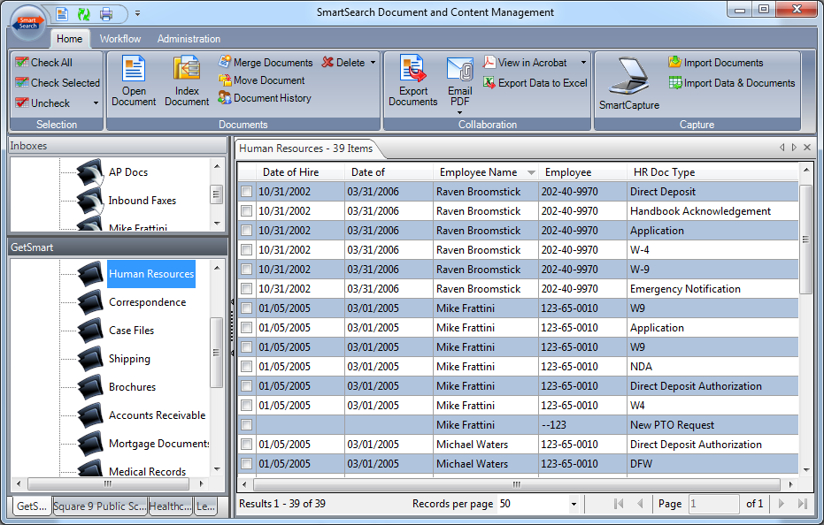
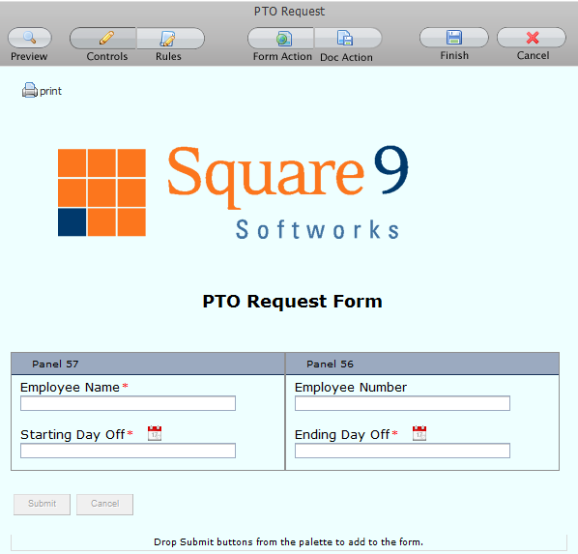
Document Management with Content Search and eForms
HRM systems are beginning to implement attach to record “document management” functionality
Support for eDocs is limited
Content search is usually not available
Automated workflows are very simplistic if even available.
Content search enables a secondary layer of search ability
eForms eliminate paper and greatly streamline capture also delivering added Green benefits.

Slide 29
Document Management with Content Search and eForms
Advantages:
Resumes can be stored in any format as content searchable documents.
Onboarding and ongoing paper forms can be turned into web based eForms.
Filling of duplicate data is eliminated, logic can be built into the form to ensure quality
Forms can be immediately routed for processing and approval.
Document workflow can build business rules into the processing of electronic documents.
  Applications, PTO requests, and employee evaluations can be routed for review and approval
  Escalations can ensure documents are processed within certain time constraints.
Line of business integration allows users to work within the HRM system
Approximate cost:
$10,000+ based on concurrent users

Slide 30
Accounting Solutions

Slide 31
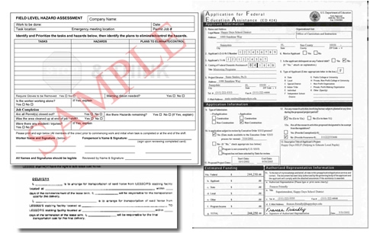
other accounting solutions
eForms
Type of documents: Requisitions, check requests, price increase request, vouchers
Digital signatures
Email Management
Correspondence and back-up documentation
Records Management
Automatically manage the retention of projects that have completed
Move, notify and purge
Compliance and Annual Audit
Sarbanes-Oxley, Sections 404 and 802
Variable Print Data Output
  Checks, PO’s, Invoices, GL reports or any multi- part forms

Slide 32
Manufacturing Solutions

Slide 33
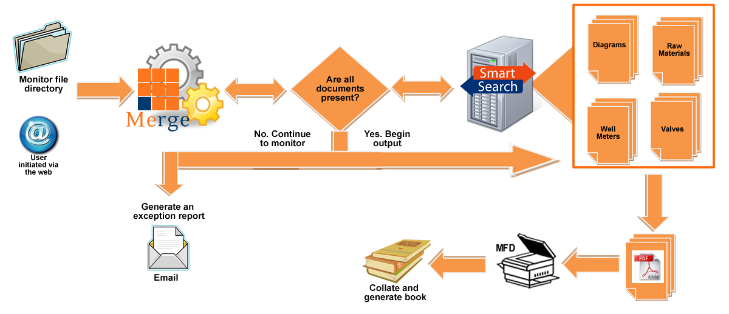
manufacturing key lead-in
Manuals, Documentation and Data Book Generation
    Variable print output from ODBC compliant data source to create on-the-fly printed materials
Business case: the world's leading supplier to the oil and gas industry, required a solution to meet the extensive process of manufacturing data books.
The process of creating a complete book takes 9 months to a year to compile

Slide 34
manufacturing solutions
Distributed Printing
Print documents to local factory network printer from central content repository
Sales Order Entry Automation
Unstructured data capture
Fax Integration
Receive and automate sales orders, warranties, applications thru advanced fax routing
Distributed capture from other domestic or international facilities
    Quality Assurance Routing
        QA documents & manage of change control
        Travelers – quality assurance sheet
Compliance
21CFRPart 11- Electronic records and signatures- maintain QA & process documents
Houston
Atlanta
Mexico
Document Management System
Middleware Printing Application
Sales Order

Slide 35
Architecture, Engineering & Construction (AEC) Solutions

Slide 36
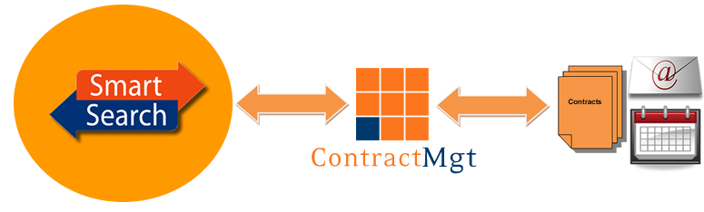

a-e-c key lead in’s
Integration
    GIS -Link maps to documents
    Timberline
Contracts Management
    Critical date tracking, management & reporting
Email Management
    Litigation support for quality issues, disasters, workers compensation,, etc
    Change Control Workflow
      Manage proposal, client acceptance and change control documents
Records Management
    Automatically manage the retention of completed projects
Merge
      Merge project docs into cohesive deliverable
Image Enable
Timberline
Bi-directional data integration

Slide 37
Financial Services Solutions

Slide 38
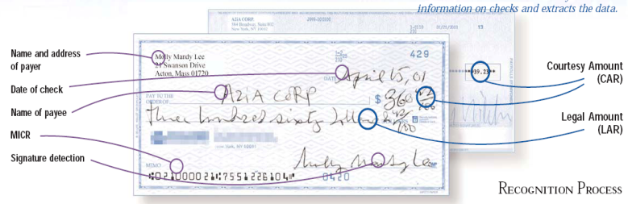
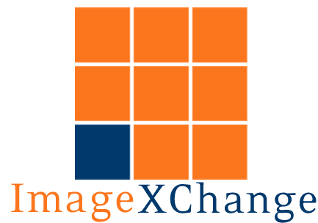
financial services key lead-in’s
Check 21
    Electronic check presentment
    Support for FedForward, FedReceipt and FedReturn
    Data feed to core processing software
    Core Processing Application Integration
    TAM
    Summit
    Metavante
    Jack Henry
    JD Edwards
    SAP
    FiServ
    Oracle Financials
    CommerceOne
    SalesLogix

Slide 39
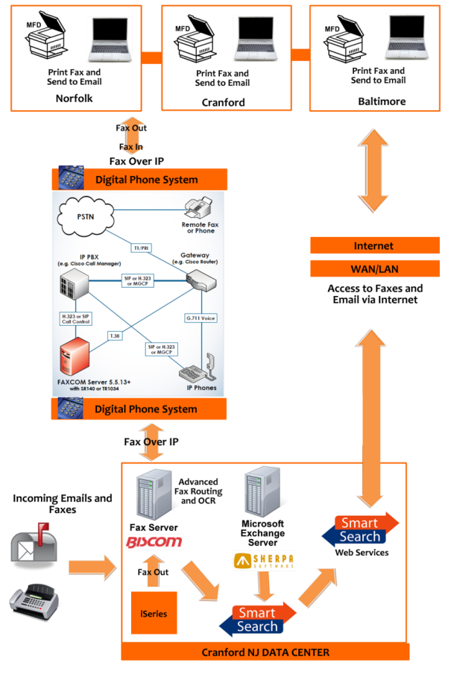
financial services solutions
    Electronic Forms
    eForms for account applications, customer service
Email Management
    Regulated industries & SEC compliance 17a-3 &4
Fax Management
    Trade tickets, mortgage documents, title search
Merge
    Loan servicing, Title search and Automotive dealer packets
    Records Management
    Automatically manage the retention of documents

Slide 40
Government and Law Enforcement Solutions

Slide 41
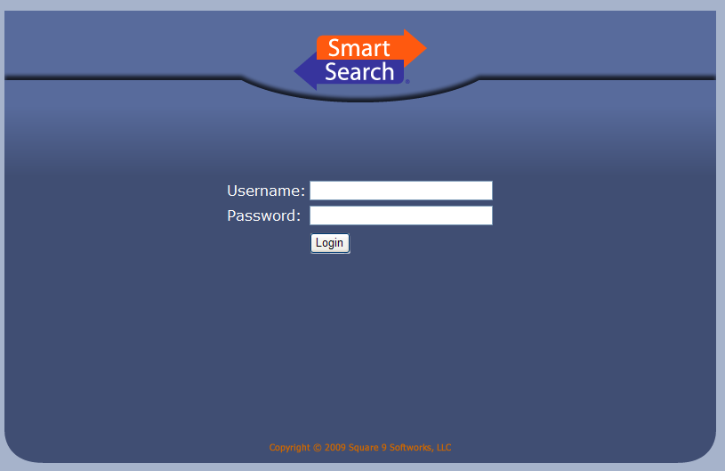
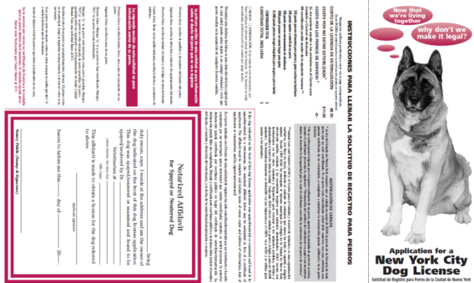
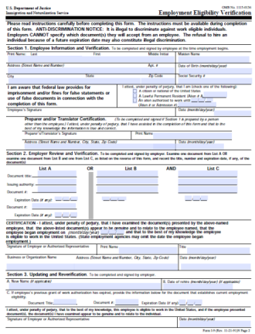
government key lead-in’s
Self-service Web Portal
    Labor records
    Town assessor data – plot maps
    Building dept
Merge
    Prosecutor office merging of case documents
Electronic Forms
    Online fishing, dog, and other permits, I-9, labor department requests
BUSINESS CONTINUITY - Disaster Recovery
    Greensburg, KS (95% of town destroyed by tornado)

Slide 42
Healthcare Solutions

Slide 43
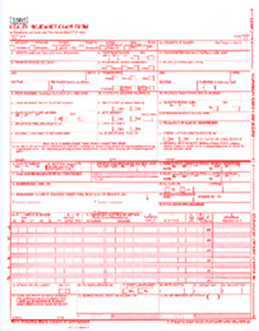
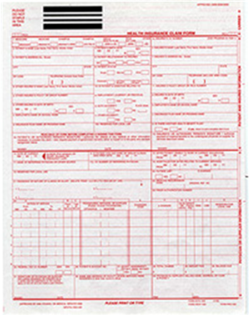
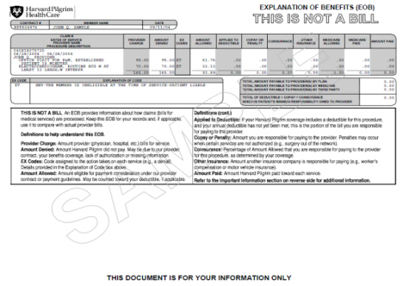


healthcare key lead-in’s
Contracts
        Critical date management of contracts -Large, very extensive equipment contract renewals
Credentialing
        Physician credentials - ensure certs, transcripts, insurance, etc, is valid
      eForms for Admitting
        HIPAA compliant sign-in application, Insurance cards, Routing notification (outpatient), T- forms and variable forms creation
Certificate of Medical Necessity (CMN) Workflow
    Required by insurance to pay patient bill
Unstructured Data Capture Engine
Adjudication System

Slide 44
Higher Education Solutions

Slide 45
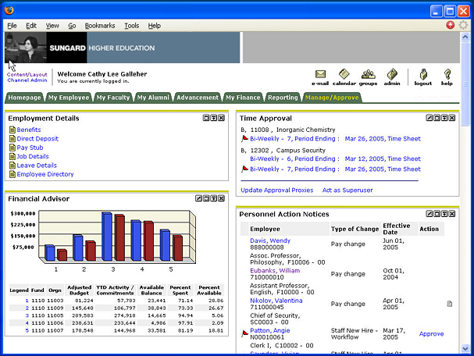
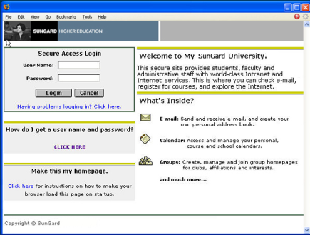
higher ed key lead-in’s
Student Web Portals
    Transcript/ credits, Homework, Syllabus, etc
    Student Information System (SIS) Integration
    Sungard Banner, Datatel Colleague, CampusPro
Records Management
Student records must be kept for 50-70 years depending on the state
Electronic Forms
        Transcript request, online registration, emergency notification, student housing, I-20 forms, admissions
Human Resources (HR) Workflows
        Teacher applications, Credentialing and student workers
Variable Print
Track bookstore purchases – data warehouse

Slide 46
K-12 Education Solutions

Slide 47


key K-12 education applications
Applications:
Special education documentation
Curriculum
IEP (Individual Education Plan)
CER (Comprehensive Evaluation Reports)
Parent, teacher and child collaboration (homework, assignments, grades, curriculum)
ePortfolios
Student records
Transcripts
Accounts Payable (invoices, purchase orders, tuition payments)
Human Resources (W2,W4, 1099, I9)
Teacher credentialing (state licenses, liability coverage, transcripts, complaints, monitoring reports)
Financial aide documents for charter or private schools
Teacher pensions

Slide 48
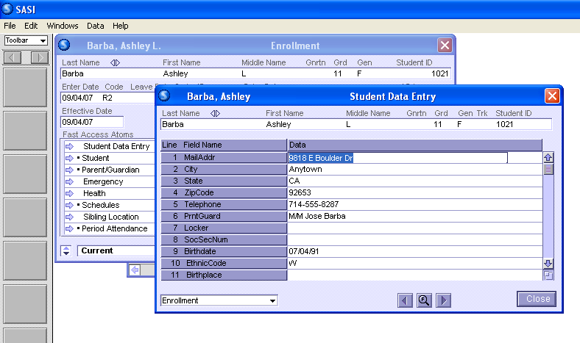
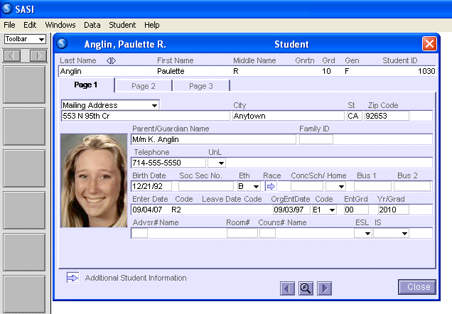
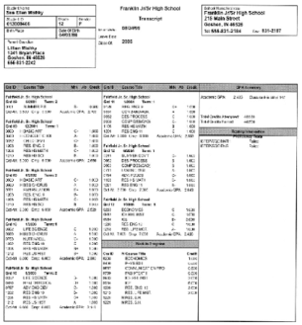
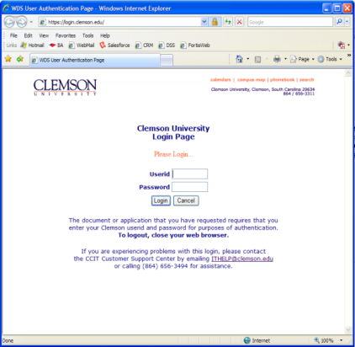
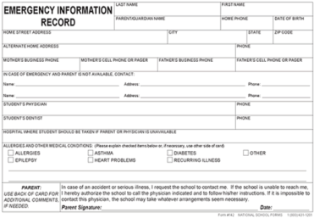
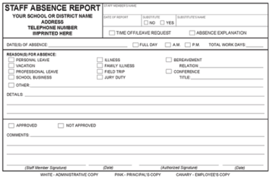
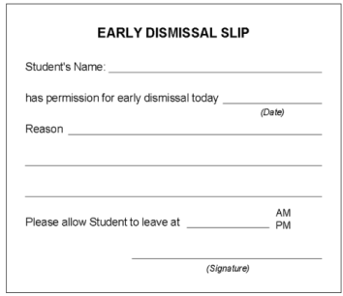

K-12 education key lead-in’s
Student Information System (SIS) Integration
Pearson SASI
Pearson PowerSchool
SIFS (School Interoperability Framework)
Forms Management
Disciplinary forms, emergency enrollment, records release, teacher hiring (HR), I-20, I-9, IEP
Self Service Web Portal
Teacher to post homework
Student/ parent portal

Slide 49
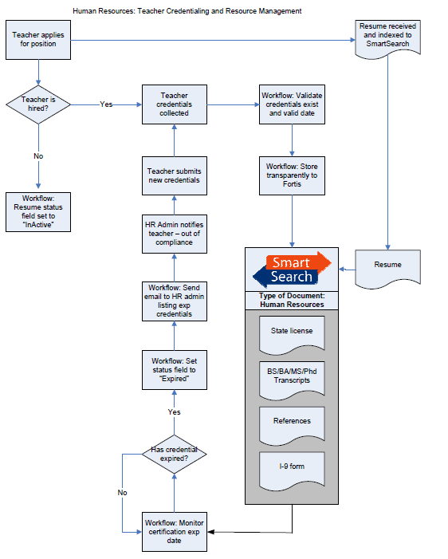

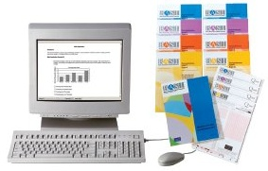
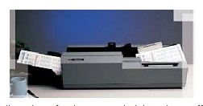
other K-12 education solutions
Workflow
Employee & retirement services
Transfer, withdrawals, admissions
IEP approval routing
Records Management
Student records must store 50-60 years
Assessments/Tests
Automated import from online Pearson Assessments
Curriculum Management
Storage of teacher and state mandated curriculum
Version control to manage changes
OCR Assessments

Slide 50
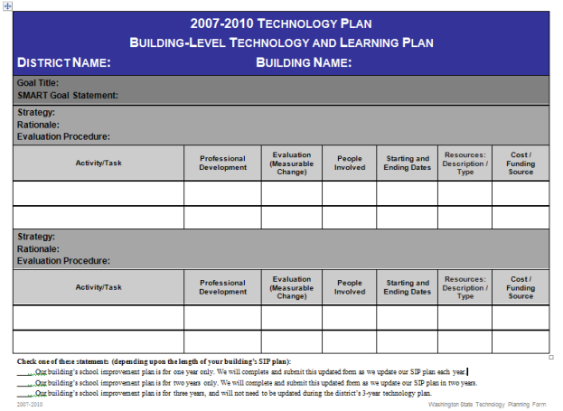
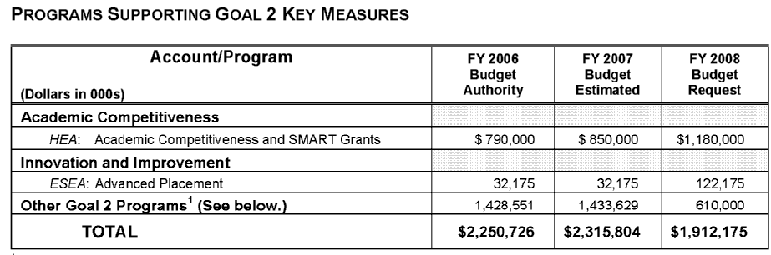


K-12 education initiatives
Annual Tech Plans
Each year schools need to revisit their technology plans which may include DMS projects
School Improvement Projects
Document management, assessments rolled into a funded school improvement budget
ESA (Educational Service Agency)
Collaborative/Distributor to all area school districts
Grants/ Funding
Manage grant process, paperwork & notifications

Slide 51
Legal Solutions

Slide 52
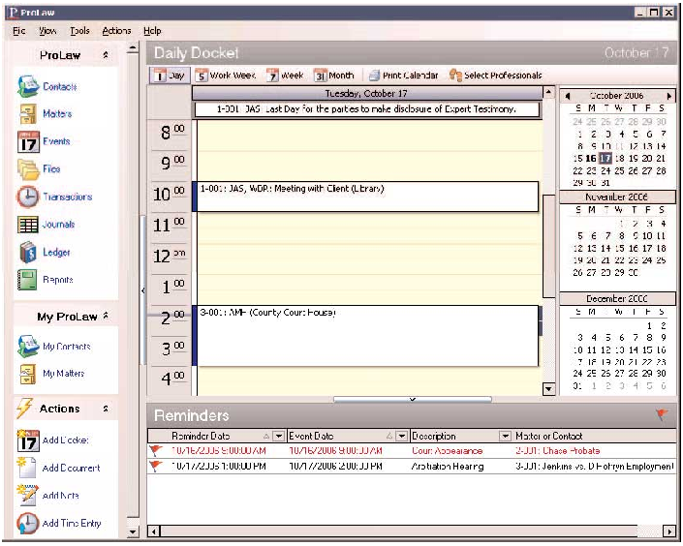
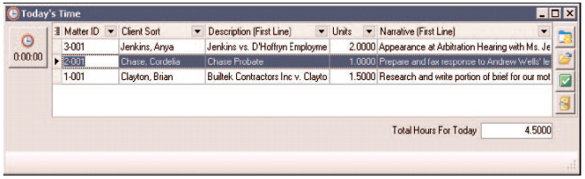
legal key lead-in’s
Case Management/ Time Billing Integration
Bates Stamping
Contracts - Critical Date Management
Track critical events such as depositions, contract negotiations, summons, court appearances
General Document Management Features
Check in/out & Versioning
Full text content search for contracts & litigation docs
Merge
Case Preparation and Release - Merge
Business case: Bergen County, NJ Prosecutor
Email Management
Public Folder collaboration
Digital asset storage upon case/matter completion
eDiscovery
Thomson ProLaw Integration

Slide 53
Brent Wesler
Square 9 Softworks
Tel: 203-752-6858
bwesler@square-9.com
http://www.square-9.com/resellers/SS_FocusedApps_v2.pptx

