Slide 1
PRODUCT NAME Proposal for COMPANY NAME
Prepared by: Quote Date
127 Church Street, New Haven, CT 06510 O: (203) 789-0889 | E: sales@square-9.com www.square-9.com

Slide 2
Square 9 Authorized Partner
Your Name
Title
Email:
Phone:
PARTNER LOGO HERE

Slide 3
Executive Summary
Customer Name has a stated objective of leaving their manual, unstructured filing system and replacing it with a central content repository that is database driven, secure and can scale to the growing needs of their business. By doing so, Customer Name will realize reduced document storage and processing costs, increased collaboration, and compliance, streamlined document administration and better preparedness in the event of disaster.
The proposed solution, outlined within this document, will help lower document storage and retrieval costs, drive document-based compliances, increase overall collaboration and provide a secure means for ensuring disaster preparedness. We would like to thank everyone for their assistance through the discovery process for providing the information necessary for this proposal.
Notes:
Optional: Write about challenges and goals in a paragraph format. Sample copy included above.

Slide 4
The Square 9 Difference
Choose Square 9 for award-winning digital transformation solutions
Innovative: Diverse offering with over 20 enhancements/year
Agile: Solutions delivered in hours vs. weeks
Customizable: Unlimited capabilities to meet your specific needs
Compliant: SOC 1, SOC 2, SOC 3, and HIPAA certified
Reliable: Customer renewal rate of over 96%
Flexible: Work the way you want, in the cloud or on-premises
Common Tasks Simplified

Slide 5
Desired Outcomes and Challenges
Challenges
Goals
Missing documents or information
Lack of visibility into…
Last payments on invoices
Consistent flow of information going to the right place at the right time
Visibility by upper management into the status of …
Eliminate all late payments
Notes:
Optional: Based on everything you’ve learned about the prospect, outline the main goals or desired outcomes in a more bulleted graphical format.
Use the number of goals that’s appropriate for your prospect, not more and not less

Slide 6
What Solution Name Delivers to Company Name
Specific benefit #1 for specific solution(s)
Specific benefit #2 for specific solution(s)
Specific benefit #3 for specific solution(s)
Specific benefit #4 for specific solution(s)
Notes:
Optional: This page is the key features with benefits that solution you are proposing supplies to the customer. This is different than goals as it should be more specific. You should have as many as makes sense for the project. This can be used vs. the other paragraph/Executive option or chart option. Could also be used in combination with one of those as well.

Slide 7
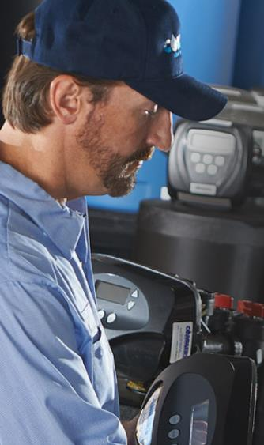
Success Story
Water Treatment & Conditioning Retailer
By implementing GlobalForms, GlobalSearch, & GlobalAction, Commers Water has reduced its sales cycle and created more visibility for upper management into their sale to product delivery process.
"The best part about this solution is the consistent flow of information going to the right place, at the right time properly. I was also happy to see that 50% of our sales staff do not use paper at all anymore by keeping their sales notes on the digital lead form and then making additional notes after the form is stored in the archive.”
Julie Ackerman, CFO and Operations Manager
“
Notes:
Include a relevant success story. Marketing is happy to quickly find an appropriate case study and share a slide if there is not an applicable one included here.
Commers Water– Reduce paper usage and more visibility for management with GlobalSearch, GlobalAction and GlobalForms

Slide 8
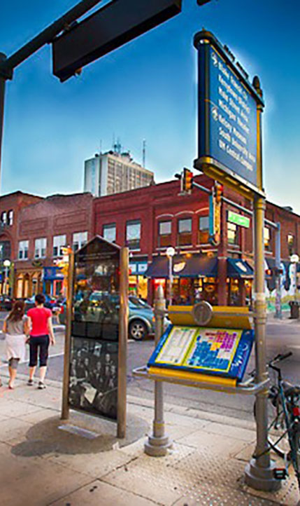
Success Story
Economic Development Organization
By implementing GlobalSearch and integrating it with their QuickBooks, Ann Arbor Sparks has drastically cut paper use, printing and the invoice approval time.
I save so much time on cross-checking invoices in the CRM and QuickBooks. Now it takes 30-60 minutes to approve a large pile of invoices, saving about 10 hours per month. I’m able to look at my reports and cross-check them in GlobalSearch, giving me more time to focus on other projects.”
Lisa Bies, Staff Accountant
“
Notes:
Include a relevant success story. Marketing is happy to quickly find an appropriate case study and share a slide if there is not an applicable one included here.
Ann Arbor Sparks – saving time with GlobalSearch and QuickBooks integration

Slide 9
Success Story
Large retail owned supermarket cooperative
The Kenny Family ShopRites of Delaware utilizes GlobalSearch in both their Accounting and Human Resources departments to eliminate paper while saving on storage space and employee time. They appreciate the ability to customize Square 9’s solution to their needs.
It’s unique in how it can be totally customized to however the end user wants to make it. It can be as simple or as complex as needed but ultimately the end result is that it saves you time, it helps you stay organized, and it’s secure, digital storage.”
Ben Simons, Information Technology Manager
“
Notes:
Include a relevant success story. Marketing is happy to quickly find an appropriate case study and share a slide if there is not an applicable one included here.
Kenny Family ShopRites – saving time, space and eliminating paper usage with GlobalSearch and GlobalForms– scalable to your needs

Slide 10
Success Story
Truckload Carrier Services
By implementing GlobalCapture, V&S Midwest Carrier Corp. was able to reduce their administrative workload by 60% and drivers no longer had to drop off paperwork at the end of each day, giving the company an additional $100,000 saved in truck expenses.
We have 150 trucks that deliver two and half loads per week. Each load usually creates at least five documents, which ends up being 2,000 documents per week. Thanks to GlobalSearch these are no longer manually indexed. This is a huge relief inside the office. As for our truck drivers, they no longer have to go those ten extra miles out of route to deliver their paperwork on time, saving us an additional $2,000 a week.”
Don Dains, VP of Technology and Operations
“
Notes:
Include a relevant success story. Marketing is happy to quickly find an appropriate case study and share a slide if there is not an applicable one included here.
V&S Midwest Carrier Corp– capture documents directly from their in-house Mobile Driver App and release them to GlobalSearch. By integrating Square 9’s solutions with their Mobile Driver App, drivers can now scan BOLs the moment they’re signed, directly through their mobile device. GlobalSearch immediately recognizes the document type and data, allowing V&S Midwest Carriers to bill that customer within a matter of minutes.

Slide 11
Success Story
Office Supply Retailer
Using GlobalCapture, Stationers, Inc. batch scans documents within a matter of seconds, eliminating the 4 hours a day normally spent filing away paperwork. GlobalSearch provides in-depth visibility eliminating the challenge of managing misplaced paperwork, saving employees at least 10 hours a week in administrative tasks like search and retrieval.
…using GlobalCapture, our processes are more user friendly and data capture is completed in a shorter amount of time. It’s a lot easier to scan in bulk and we have complete confidence that the data is accurately being captured and indexed away where it needs to be.”
Jennifer Walters, Office Process Manager
“
Notes:
Include a relevant success story. Marketing is happy to quickly find an appropriate case study and share a slide if there is not an applicable one included here.
Stationers, Inc. – basic file, storage and retrieval saving time. More friendly and accurate system than their past solution.

Slide 12
Success Story
City Clerk Office
Since the implementation of Square 9’s GlobalCapture and GlobalSearch solutions, the City of Jackson City Clerk’s Office estimates that paper use has decreased by 30%, and there has also been a considerable cut in dollars spent on storage and printing costs.
The City Clerk’s Office uses GlobalSearch daily! Square 9’s software offers many functions that are beneficial to us. Specifically, we use the Keyfree Indexing feature very often! This allows us to avoid manual data entry and saves lots of time.”
Shanekia Mosley, Deputy City Clerk
“
Notes:
Include a relevant success story. Marketing is happy to quickly find an appropriate case study and share a slide if there is not an applicable one included here.
City of Jackson, MS – Reduce paper usage and costs

Slide 13
Success Story
Automotive Vehicle Dealership
With GlobalSearch, Donley Auto Group enjoys a simplified version of its customary procedures with less much of the paper. Critical records are available to authorized users at any Donley location instantly. The information is literally “at their fingertips.” Efficiency has improved dramatically and measurably. It is estimated that cashiers at all four locations are each saving up to eight hours per week—a 20-percent reduction in labor costs for these employees.
GlobalSearch resolved many customer relations issues and has definitely helped us to retain customers.”
Candy Bores, IT Manager
“
Notes:
Include a relevant success story. Marketing is happy to quickly find an appropriate case study and share a slide if there is not an applicable one included here.
Donley Auto Group– Easy and fast access to critical documents across four locations improving customer service.

Slide 14
Success Story
County Clerk Office
By implementing GlobalSearch, taxpayer savings have increased, over 25% of office paperwork has been eliminated, and Floyd County was able to hire a part-time employee instead of filling the vacant full-time position, saving them around $18,000 annually.
Not only have we eliminated stacks of boxes, but now when we receive the 1,000 lines every quarter, one person can pull and match all the information they need within a couple of days. Plus, with importing, there’s no balancing and no human data entry errors to worry about. Looking for missing applications has decreased to almost zero.”
Amanda Pahmeier, First Deputy Auditor
“
Notes:
Include a relevant success story. Marketing is happy to quickly find an appropriate case study and share a slide if there is not an applicable one included here.
Floyd County, Indiana – documents can be found quickly and are pulled up and printed on the spot, eliminating the risk of misplaced paperwork. Not only has this led to easier collaboration, but audit trails help them to abide by government regulations as well.

Slide 15
Success Story
Music Publishing Powerhouse
Implementing GlobalSearch and GlobalAction, SonyATV has streamlined their financial processes and the 28,000 yearly cue sheets detailing the use of music in films and TV. The automated workflows has helped organize the mass volume of documents being managed.
Since implementing GlobalSearch, our team has streamlined many key processes across several departments. The scanning and indexing process of 2,000 monthly paper check copies has been fully replaced with the automatic creation of PDF docs from our Financial ERP system into GlobalSearch. In total, approximately 400 hours of manual work has been eliminated.”
Todd Sears, IT Director
“
Notes:
Include a relevant success story. Marketing is happy to quickly find an appropriate case study and share a slide if there is not an applicable one included here.
SonyATV Music Publishing– workflow is streamlining processes eliminating hundreds of hours of manual work.

Slide 16
Success Story
Prestigious Catholic High School
By implementing GlobalSearch and GlobalCapture, Saint John Paul the Great Catholic High School staff has saved over 200 hours across departments and has increased productivity by at least 10%.
Square 9’s solutions are being used across multiple departments including Finance, Human Resources, Administration, Registration, Medical and more. GlobalSearch was great for its seamless integration with PowerSchool. We use PowerSchool daily so now if we are looking at a record in PowerSchool we could easily pull up matching records in GlobalSearch.”
David Morales, Director of Technology
“
Notes:
Include a relevant success story. Marketing is happy to quickly find an appropriate case study and share a slide if there is not an applicable one included here.
Saint John Paul the Great Catholic High School – Reduce paper, save time and integration with PowerSchool

Slide 17
Product Name Proposal
A single solution for transforming efficiency in any district
Square 9’s Education Essentials Bundle includes:
GlobalSearch Cloud for Workgroups (3 concurrent users)
50 GB Cloud Storage
Cloud Transformation Services for up to 1,000 pages per day
Two GlobalForms enabled workflows
Access to the Square 9 Solutions Delivery Network
Free use of the Square 9 Forms Library
Unlimited Online Education
One Day of Professional Services for delivery and training
This is an Estimate only. Final numbers will be provided upon a formal scoping engagement and completion of a Statement of Work. Quote is valid for 30 days from quote date.
Notes:
Details on what is being proposed and list of what is included.

Slide 18
Project Investment
Description | Qty.
Solution License | X
Implementation Services
Summary | Investment
Software Subscription Details | $X,XXX.XX
Line Item – Support? | $X,XXX.XX
Line Item - Implementation Services (one-time investment)? | $X,XXX.XX
Line Item | $X,XXX.XX
Line Item | $X,XXX.XX
This is an Estimate only. Final numbers will be provided upon a formal scoping engagement and completion of a Statement of Work. Quote is valid for 30 days from quote date. Pricing is in U.S. dollars. Prices do not include applicable taxes.
Notes:
Proposed costs – estimate only

Slide 19
Return on Investment
Reduce to the Ridiculous - Cost |  |  | Reduce to the Ridiculous - ROI
GlobalSearch Concurrent Licenses being Sold | 3 |  | Profitable Operating Efficiency Gain per Hour | $4.89
Total Users of GlobalSearch expected | 3 |  | Total Users of GlobalSearch expected | 3
Cash Price or Lease Payment | $16,120.00 |  | Total Per Hour Gain | $14.67
Term if Leased | 0
Total Monthly Spend | $268.67 |  | Total Daily Gain (8 hour working day) | $117.39
Daily Spend (22 business days) | $12.21 |  | Total Monthly Gain (22 business days) | $2,582.53
Hourly Spend (8 hour working day) | $1.53 |  | Total Annual Gain (12 months) | $30,990.40
Total Hourly Rate by License Count | $0.51 |  | Total Gain over 5 years (60 months) | $154,952.00
Total Hourly Rate by Expected User Count | $0.51
Avg Hourly FTE Expense | $20.00
27% Hourly Efficiency Increase (Industry Average) | $5.40 |  | Cost of Lost Labor over 5 years (all in) | $154,952.00
GlobalSearch Hourly Increase | $0.51
Profitable Operating Efficiency Gain | $4.89 |  | Profitable Return on Investment | $154,952.00
(Per Hour Per Employee) |  |  | (Total Business ROI)
Notes:
Optional ROI slide for GlobalSearch

Slide 20
Pre-Project Success Plan
Statement of Work Received
A project plan in Square 9’s tracking system is created. The project goals and objectives are assessed by the Professional Services Manager. Any potential obstacles are flagged, and the customer is notified.
Engagement & Pre-call Scheduling
The Square 9 admin team will schedule engagement dates. Also, a pre-engagement call to discuss the implementation and its requirements for both parties will be scheduled.
Pre-Engagement Call
On the pre-call your assigned resource will discuss your project goals and objectives. We will also discuss other requirements depending on your project including hardware/server requirements, client’s needed resource availability and project timeline. Notes and discussions are recorded on a work order that follows the life of a project.
Engagement
Notes:
This can be adjusted to your plan. We did not include post engagement to keep it quick and open to adjustments after the proposal is signed.

Slide 21
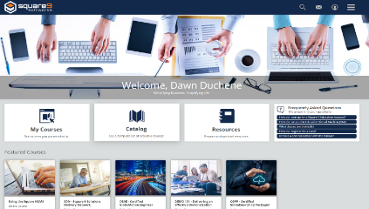
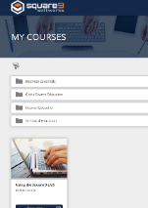
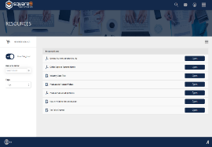
Education
Ensuring your success
Turn your team into experts with a full curriculum of courses offered to you at no cost.
Courses are available online either as “learn at your own pace” through Square 9’s eLearning education portal or as virtual instructor-led classes.
Welcome, Your Name Here
Notes:
Promotion of free eLearning which is an advantage over competitors like Laserfiche who require you pay.
It’s Square 9’s strong belief that our customers get the most for their money when they get the most from their software. We have a complete library of online learning tools to help everyone from casual users to System Administrators and everyone in between.

Slide 22
Next Steps
Ready to get started? It’s easy:
Sign Agreement - X/X/XX
Execute Agreement – X/X/XX
Project Kick Off – X/X/XX*
Project Completion – X/X/XX*
We’re excited to work with you! If you have any questions prior to accepting this proposal, don’t hesitate to contact us at [email and/or phone number].
*These are estimated dates based on current inputs. A detailed scheduled will be provided at project kick off.
Notes:
Tell them what to do next with due dates. Don’t leave it open-ended.

Slide 23
Questions
Key Contacts:
Sales Support Name Phone Email
Professional Services Support
(203) 789-0889 projectstatus@square-9.com
Technical Support
(203) 789-0889 Option 2 support@square-9.com
Notes:
Add or subtract key contacts as necessary

