Slide 1
Square 9 Softworks
Brand Book 2023

Slide 2
Logos
‹#›

Slide 3
Primary Logo
The Square 9 logo has two components - the designator and the logotype. The designator must be used as part of the logo in all communications. Our logo is designed to visually and symbolically express our brand. Altering our logo can weaken our brand.

Slide 4
Alternative Logos
The logo can only be displayed in Square 9 orange and navy, orange and white.

Slide 5
Logo / Co-Branding
When co-branding with Reseller partners, as a general rule, both logos should appear in conjunction with, and be similar in size as, the partner brand. Enough distance is required to clearly show that each partner companies are different entities. If not in conjunction, the same rules of sizing should still apply. For all co-branded material, the Square 9 authorized Reseller logo should be used.

Slide 6
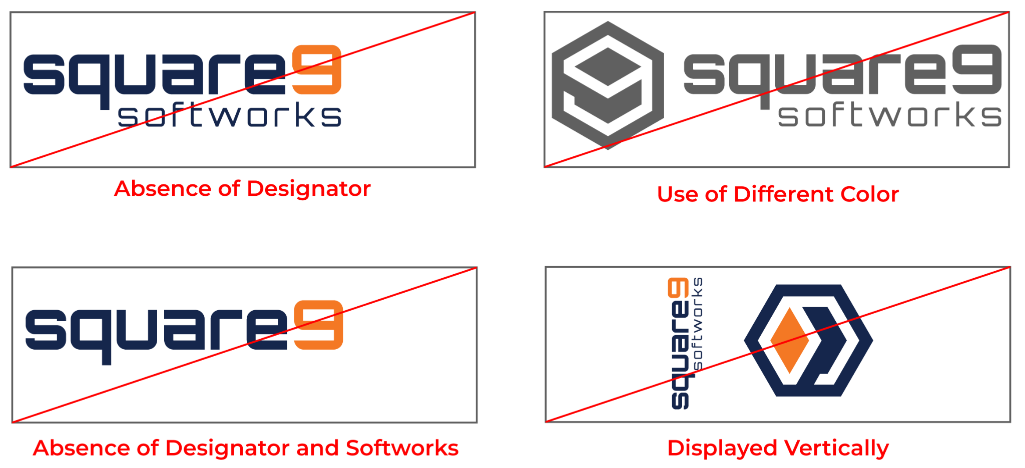
Logo / Prohibited Use
Below are examples of Square 9 logos that are misused or missing elements. Please defer from using these examples.

Slide 7
Typography
‹#›

Slide 8
Typography
The typeface for copy and communications, marketing, heading, and graphics purposes are below:
Monsterrat | Montserrat Medium | Montserrat Semibold
Century Gothic | Century Gothic | Century Gothic

Slide 9
Color Palette
‹#›

Slide 10
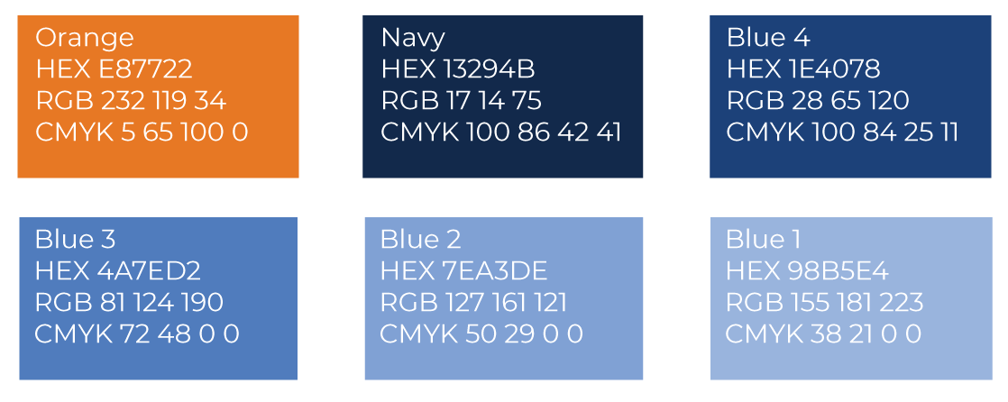
Brand Color Palette
The primary colors are navy and orange. These are the main colors that are core to Square 9’s brand and identify the company logo. In addition to the navy and orange, Square 9 utilizes a range of blues that should be used as a complement to the main brand colors in design elements.

Slide 11
Icons &
Images
‹#›

Slide 12
Brand Icons

Slide 13
Brand Illustrations

