Slide 1
Square 9 Brand Book

Slide 2
Logos

Slide 3
Primary Logo
The Square 9 logo has two components - the designator and the logotype. The designator must be used as part of the logo in all communications. Our logo is designed to visually and symbolically express our brand. Altering our logo can weaken our brand.

Slide 4
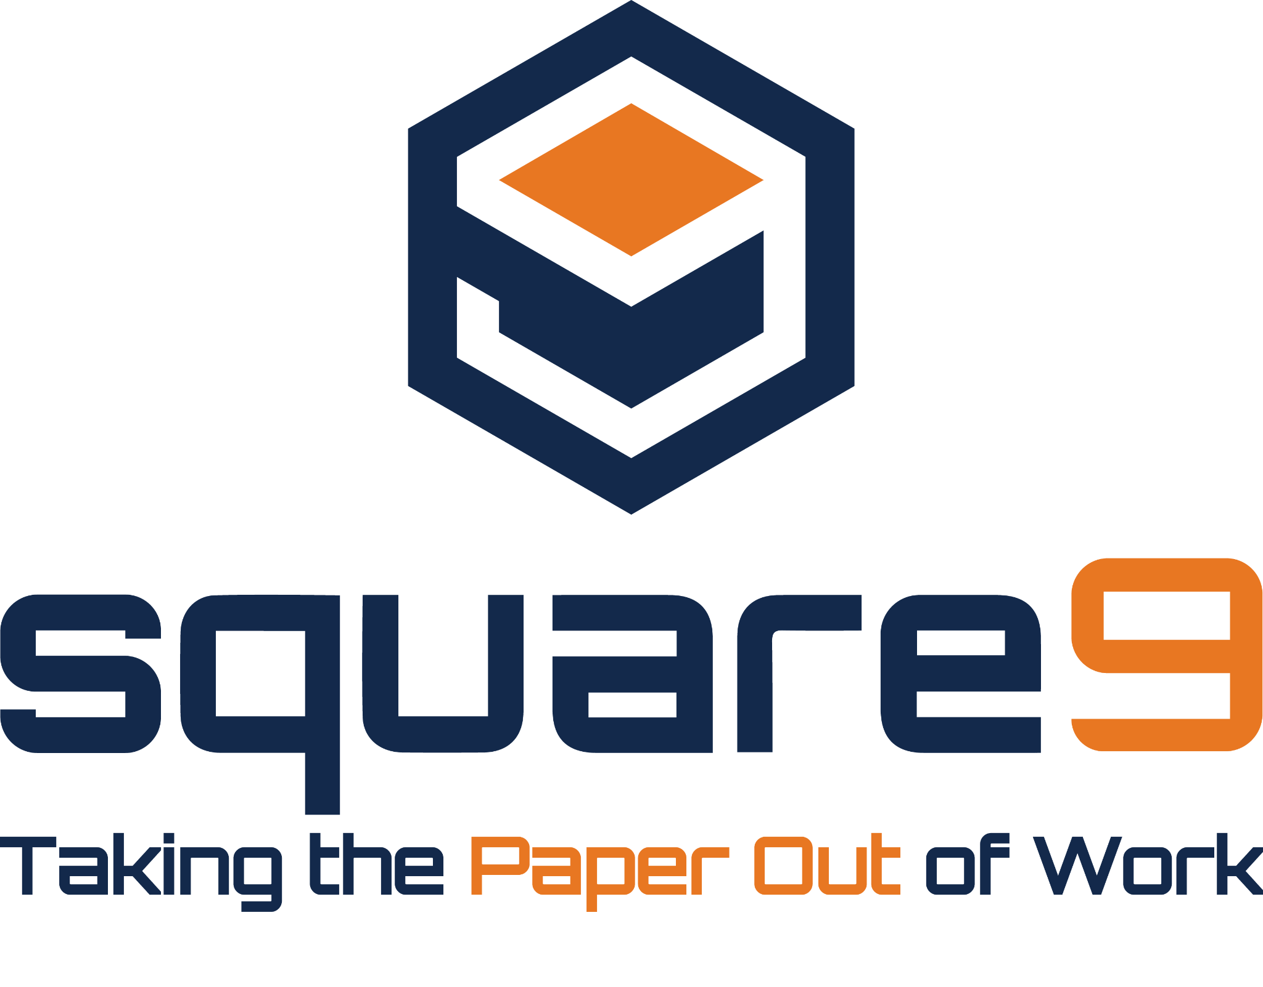
Alternative Logos
The logo can only be displayed in Square 9 orange and navy, orange and white.

Slide 5
Alternative Logos for Small Images and Apparel
Used for graphical images where the logo is too small and the tagline cannot be read. Also used for t-shirts, polos, button-downs, etc. The logo can only be displayed in Square 9 orange and navy, orange and white.

Slide 6
Logo / Prohibited Use
Below are examples of Square 9 logos that are misused or missing elements. Please defer from using these examples.
Absence of Designator
Use of Different Color
Absence of Designator and Softworks
Displayed Vertically

Slide 7
Logo / Co-Branding
When co-branding with Reseller partners, as a general rule, both logos should appear in conjunction with, and be similar in size as, the partner brand. Enough distance is required to clearly show that each partner companies are different entities. If not in conjunction, the same rules of sizing should still apply. For all co-branded material, the Square 9 authorized Reseller logo should be used.

Slide 8
Typography

Slide 9
Typography
The typeface for copy and communications, marketing, heading, and graphics purposes are below:
Monsterrat | Montserrat Medium | Montserrat Semibold

Slide 10
Color Palette

Slide 11
Brand Color Palette
The primary colors are navy and orange. These are the main colors that are core to Square 9’s brand and identify the company logo. In addition to the navy and orange, Square 9 may utilize blues that should be used as a complement to the main brand colors in design elements.

Slide 12
Iconography & Images

Slide 13
Iconography

Slide 14
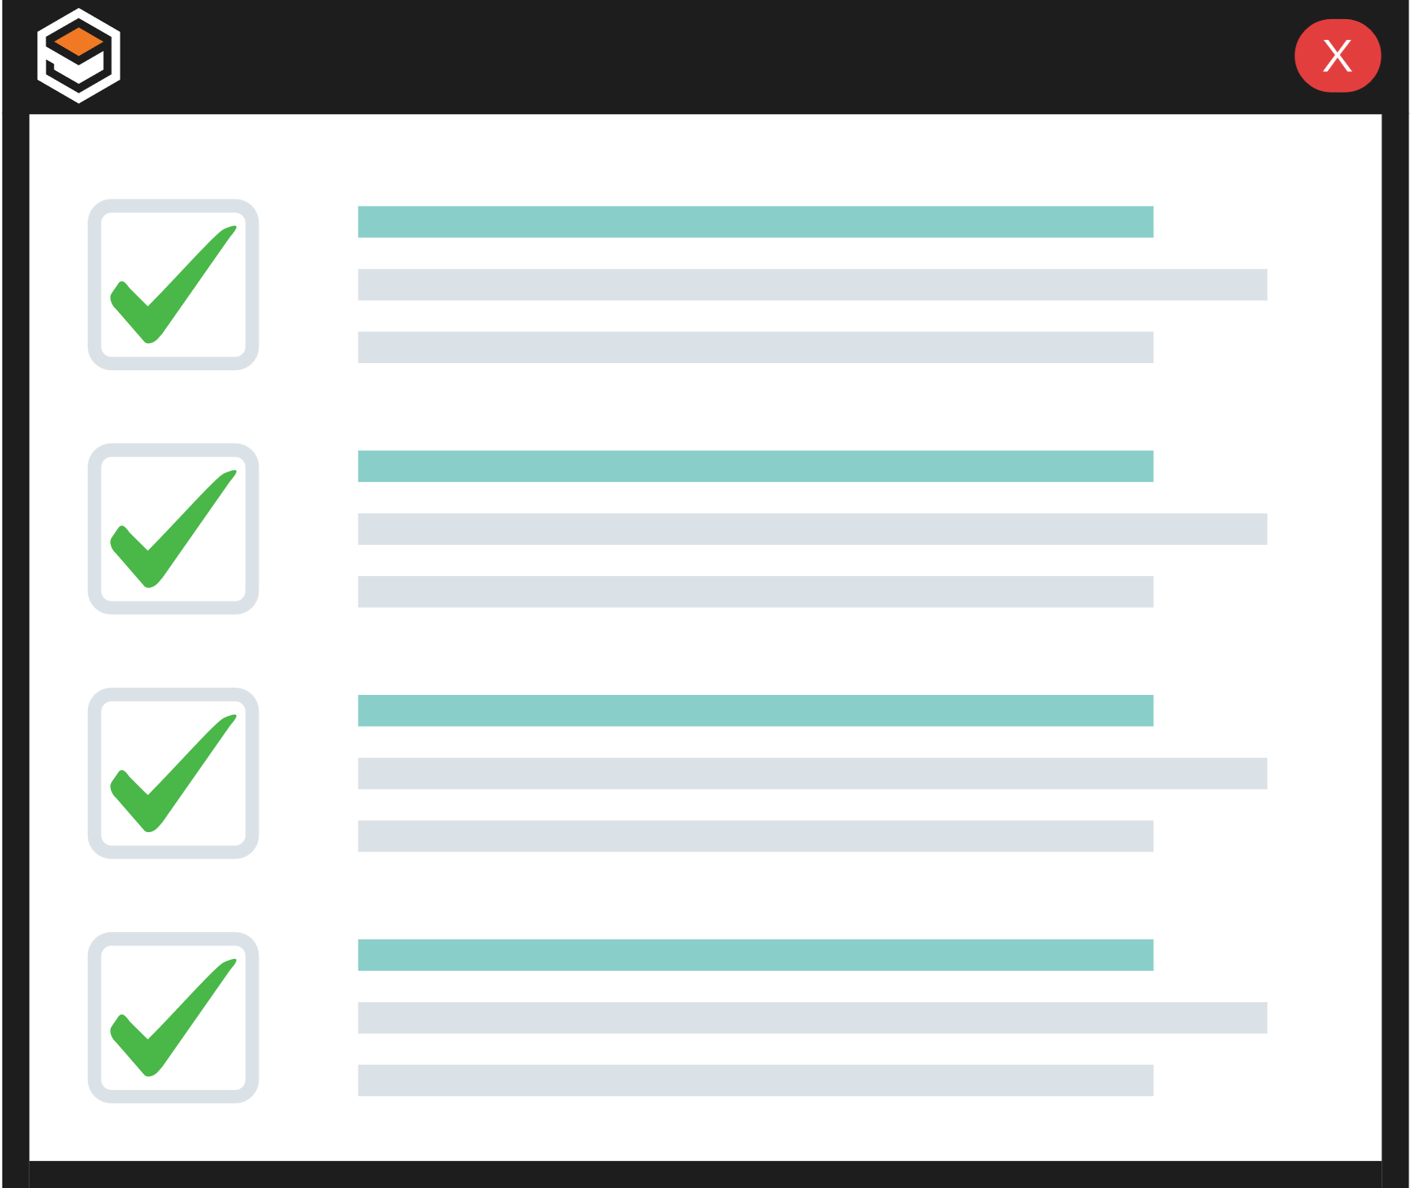
Brand Images

