Slide 1
Taking the Paper Out Of Work
Stephen Young | President/CEO

Slide 2
Agenda
What is Intelligent Information Management
Introduction to the Company
Go To Market Strategy
Product Review
Strategy & Initiatives
Departmental Breakdown

Slide 3
What is Intelligent
Information Management?
Transform
Identifying inefficient paper-based processes and digitizing them for greater downstream effectiveness
Secure & Protect
Securing and encrypting information so it’s available only to the right people at anytime from anywhere regardless of location.
Automate
Putting digitized information into motion while enforcing business rules for, approvals, notifications, decision making and for sharing with other applications.

Slide 4
The Global Market For IIM Products
ECM 2021 listed as a 23.6B industry with an expected 5-Year CAGR of 9.8% (37.7B)
Document Management listed at 5.5B with an expected 5- Year CAGR of 13.05%
Document Capture Software listed as a 1.9B industry with a CAGR of 10.7% by 2026
Web Forms Automation software market listed as 7.09B in 2019 with a 5-year CAGR of 17.97% by 2026
- AIIM 2021

Slide 5
The Square 9 Difference
Taking the Paper Out of Work
The Square 9 platform is intelligent information management software that takes the paper out of work.
We make it easier to get things done with digital workflows that automate many aspects of how you work today.
We achieve this by extracting information from scans or PDFs, storing documents in a searchable archive, and building digital twins of your current processes.

Slide 6
Square 9’s Go To Market Strategy
Growing Reseller Profitability Requires More Than Just a Strong Product
Unparalleled Pre-Sales and Post Sales Support Programs
In House Professional Services with Delivery Guarantee
Easily adopted Solutions that deliver rapid ROI
Free online education program
Square 9 sets itself apart through a unique level of products, service and support.

Slide 7
The Square 9 Solution Platform
GlobalCapture
GlobalAction
GlobalSearch
GlobalForms
Offering complete digital transformation
Document Capture Automation
Transforming content into high value information
Business Process Management
Putting information into motion
Enterprise Content Management
Secure access, storage and retrieval of business-critical documents
Web Forms Management
Highly-efficient information capture

Slide 8
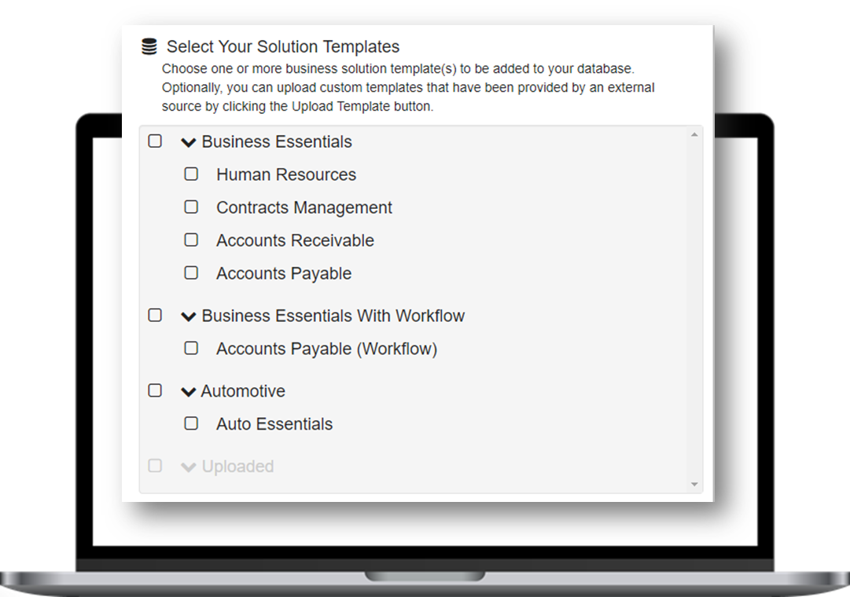
The Solutions Delivery Network
Simplifies the capture, retrieval, organization, and distribution of business information while improving productivity.

Slide 9
Business Essentials
Available through the Solutions Delivery Network
Addressing areas common to every business that benefit from ECM automation
Accounts Receivable
Accounts Payable
Contracts Management
Human Resources
Touchless Health Screening
Ranging from $126 - $375 per month for three concurrent users depending on the required level of automation

Slide 10
The 2023 Reseller Program
Business Partner
Elite Partner
Authorized Partner
Three Benefit Levels
Ranging from Limited Commitment to Maximum Return

Slide 11
Objectives
Provide full participation in ARR for all Resellers regardless of their level of commitment
Allow Smaller Resellers to Grow Their ECM Practice Over Time
Eliminate the cost of staffing a support desk for our Resellers by Offering a Direct Support Model
Give Resellers the Opportunity to use Square 9 Products in the Cloud at little or no cost
Empower fully committed resellers with the opportunity to maximize their margins

Slide 12
Business Partner Level
No commitment
No reseller fee
No Minimum Activity Requirement
No Revenue Targets
No Training Requirements
20% On Software and Subscriptions
20% On Professional Services
20% On Subscription Renewals
No Help Desk Responsibilities
All Support Provided by Square 9
Unlimited Access to Demonstration Software

Slide 13
Authorized Partner Level
$3,500 Annual Fee
Earn back 50% of the Annual Fee with 25K in Sales
Earn back 100% of the Annual Fee with 50K in Sales
New Opportunity Minimum of 25 per year
Sales Level I Training Required
No Technical Certification Required
40% on Software and Subscriptions
20% on Professional Services
20% On Subscription Renewals
All Support Provided by Square 9
Authorized Partners receive a 5 User Digital Transformation Essential bundle with 1,000PPD, 5 Forms, and TransformAI

Slide 14
Elite Partner Level
Annual Renewal Fee Waived
Revenue Requirement of $100K per year
New Opportunity Minimum of 40 per year
Minimum Support Deck of 20 Customers
Sales and Technical Training Requirements
Annual Recertification Required
40% on Software and Subscriptions
20% on Professional Services
40% On Subscription Renewals
Partner Provides Level 1 Support
Elite Partners receive a 5 User GlobalSearch Cloud Enterprise bundle with 1,000 PPD, five (5) Form Workflows and Unstructured Data Extraction with TransformAI

Slide 15
Calculating Performance
Reseller Performance will be calculated to optimize the shared objective of building Annual Recurring Revenue
1X for all Perpetual License Revenue
1X for First Year Maintenance & Support Contracts
1X for All Professional Service Revenue
2X ARR for all subscription-based Licensing
(Cloud or On Premise)

Slide 16
Q&A

