Slide 1
Taking the Paper Out Of Payables
Dynamics 365 GlobalAutomation
For Business Central
Copyright © 2023 Square-9 Softworks Inc. All Rights Reserved

Slide 2
Agenda Slide
01
Introduction
02
What is Dynamics 365 GlobalAutomation?
03
Five Steps to Efficiency
04
Your Flow of Information
05
Standard Investment Breakdown
06
Q&A

Slide 3
What is Dynamics 365 GlobalAutomation for Business Central?
GlobalAutomation combines AI driven data extraction and Accounts Payable Automation to intelligently create Vendor Invoices in Dynamics 365 Business Central without the need for manual data entry.

Slide 4
The Unique Benefits of GlobalAutomation
Delivers highly accurate AI Driven data extraction of invoice and receipt fields to eliminate the need for manual data entry
Includes full business process automation platform to manage the validation and approval routing of invoices throughout your organization
Incorporates a no-code integration platform for Dynamics 365 Business Central which allows for the free flow of information between your applications
Combines the best of Intelligent Information Management with Account Payable Automation so you can expand your digital transformation strategy company wide.

Slide 5
The Five Steps to Efficiency
How GlobalAutomation Transforms Your Payables Process

Slide 6
Five Steps to Efficiency
GlobalAutomation Goes Far Beyond Just Intelligent Data Extraction with a complete solution for Accounts Payable Automation
Image Transformation
Data Validation
The Paper, Image, PDF, or digital records are transformed into usable information through AI-Driven data extraction
Approval Routing
User validation of the extracted data is performed for QA using confidence- based reporting of the extracted information
Data Release to Business Central
The digitized image is assigned to the appropriate manager for approval and General Ledger assignment
Image Archival
The approved invoices is routed back to Accounts Payable who releases invoice data to Business Central to automatically create the payable
The invoice image is released to GlobalSearch and as an attachment in Business Central. Optional repositories are also available. (Google Drive, Citrix Sharefile, SharePoint)

Slide 7
Step 1 - AI Driven Image Transformation
All Accounts Payable automation begins with the accurate extraction of invoice information

Slide 8
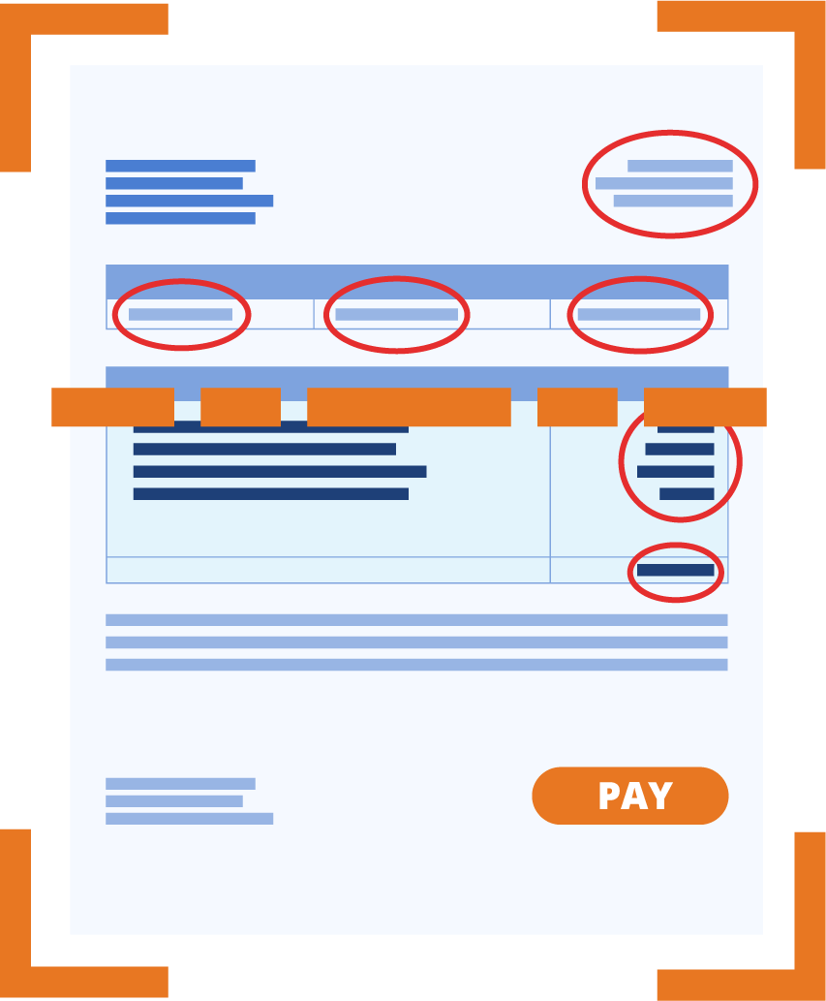
ELIMINATING THE NEEED FOR DATA ENTRY
Let Highly Accurate AI Eliminate the Need for Manual Data Entry:
Invoice Date
Invoice Number
Invoice Taxpayer ID
Customer Number
Account Number
Vendor Name
Vendor Address
Vendor Phone
Vendor Website
Receiver Name
Receiver Address
Receiver Phone
Order Date
Due Date
Delivery Date
PO Number
Terms
Total
Amount Due
Amount Paid
Subtotal
Tax Amount
Service Charge
Tip Amount
Prior Balance
Discount
Shipping

Slide 9
Step 2 - Data Validation
Ensure accuracy with Confidence Driven Data Validation

Slide 10
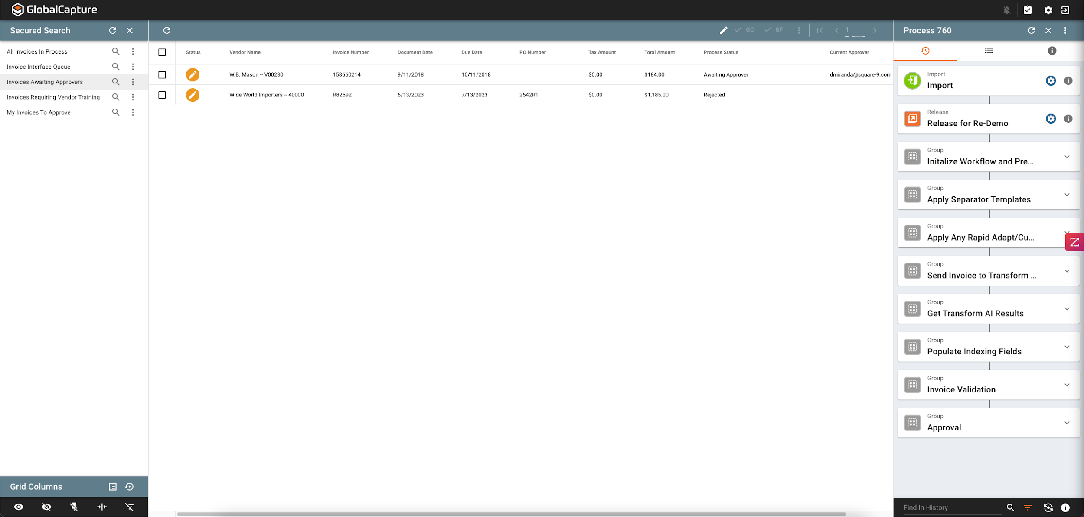
EASILY SEARCH AND VIEW ANY INVOICE STATUS
Invoices are instantly available to view their Stage, Approval or Process Status :

Slide 11
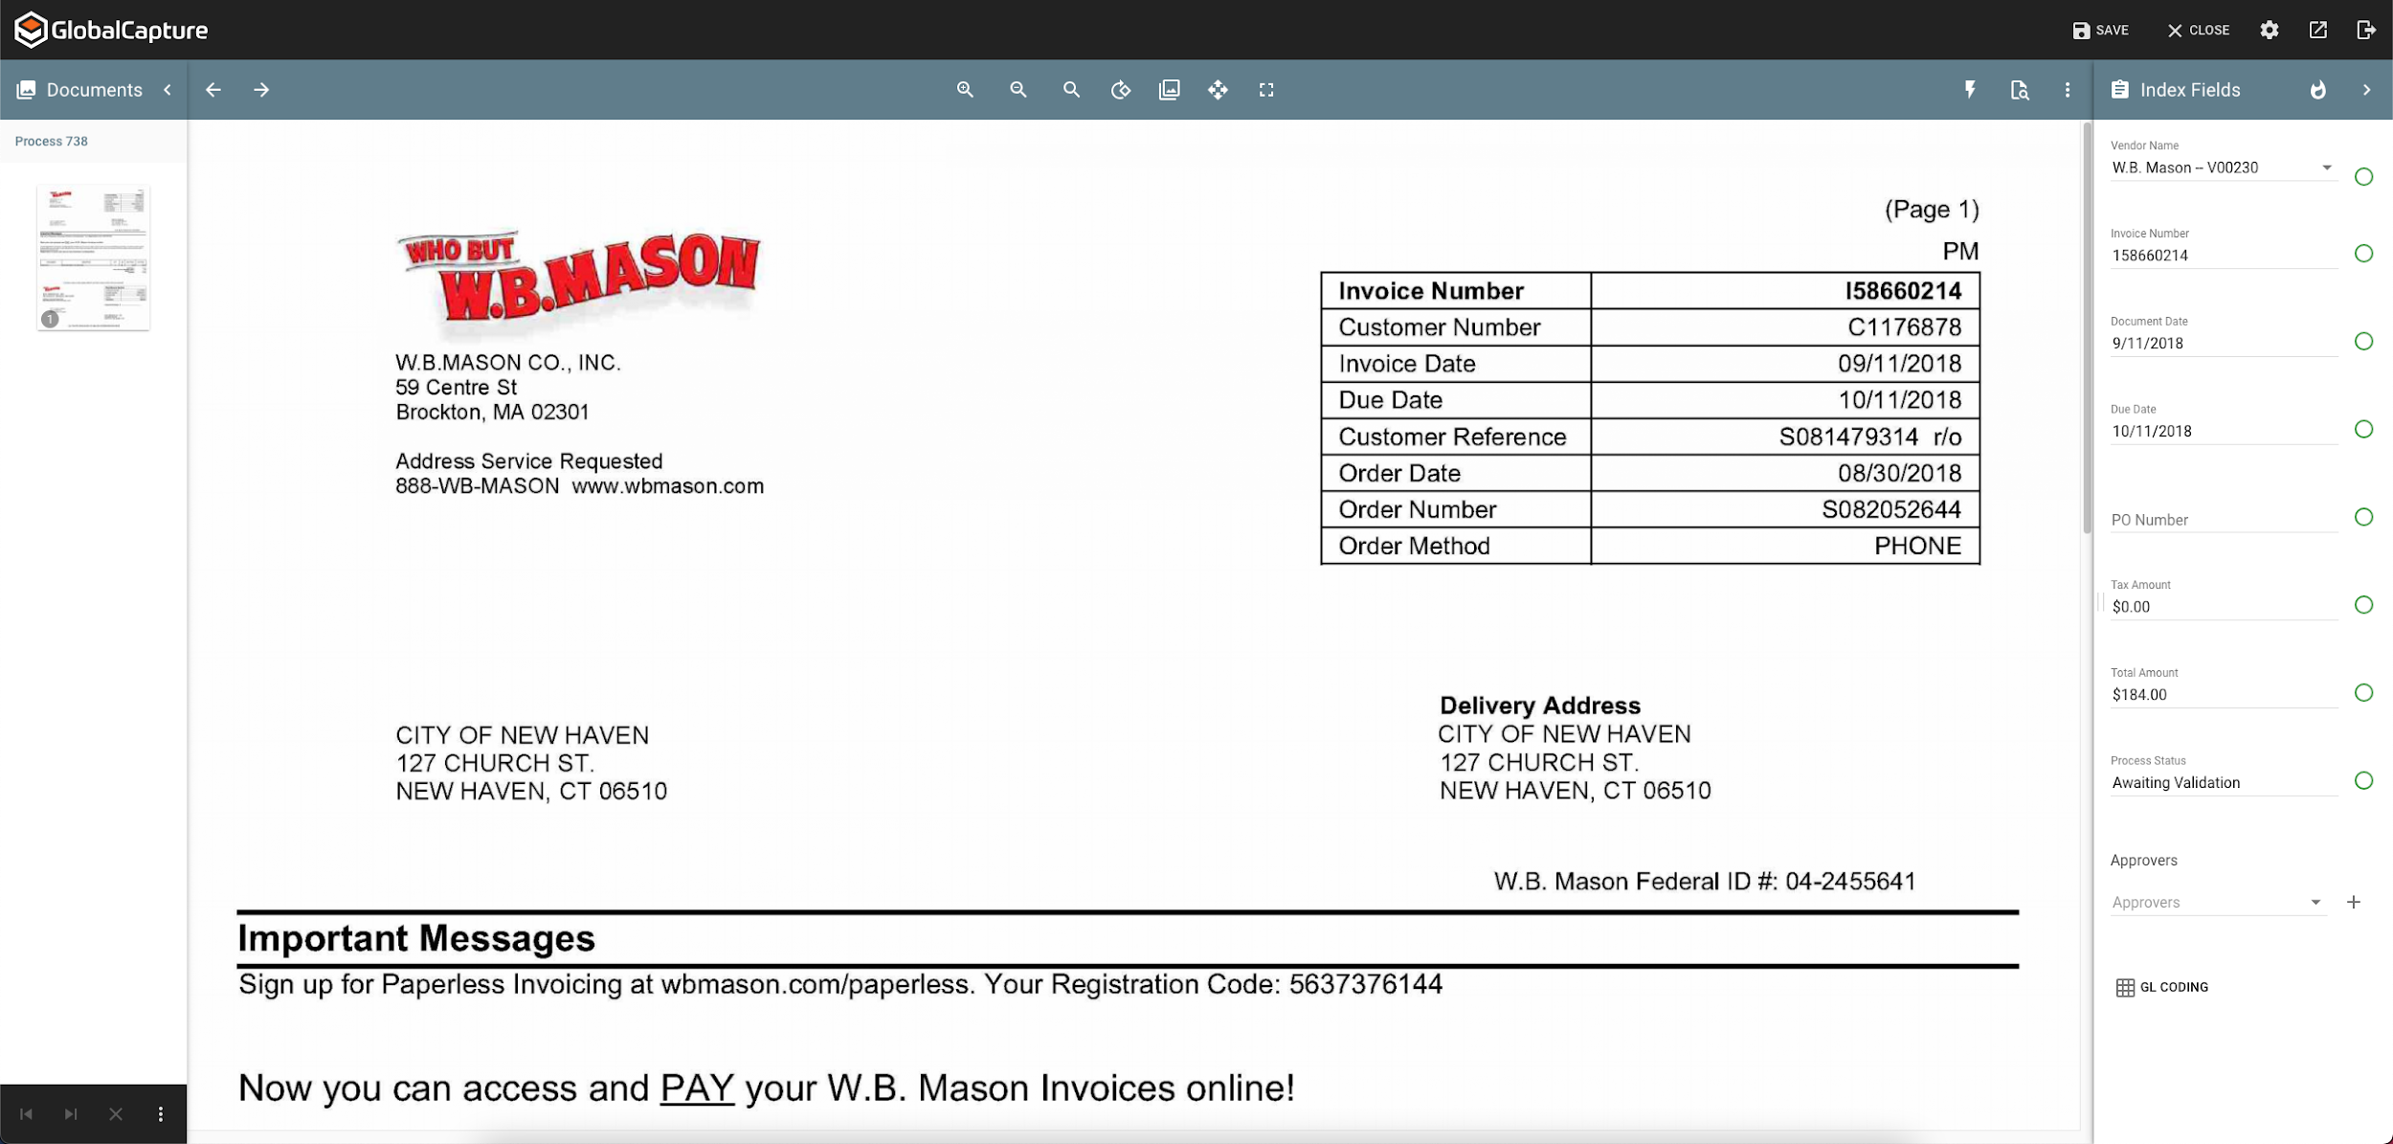
CONFIDENCE BASED DATA VALIDATION
Ensure the integrity of your data before releasing it to Business Central with confidence- based data validation :

Slide 12
Step 2 - Route For Approval
Routing Payables for Approval Regardless of Where Your Team is Working

Slide 13
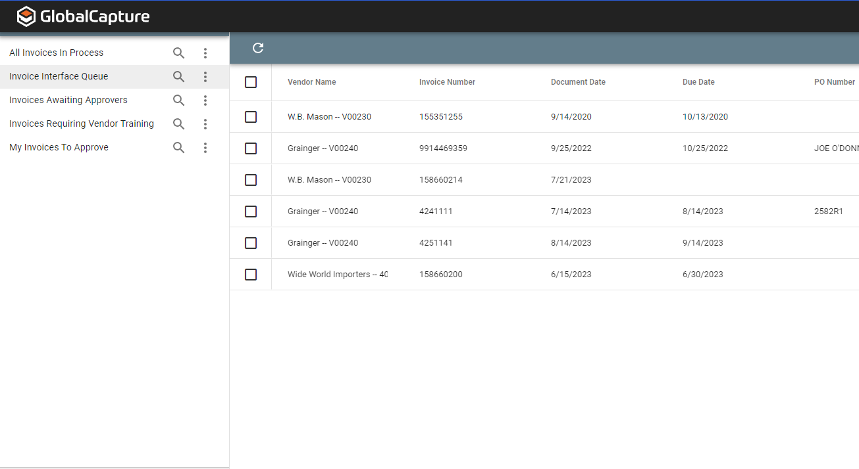
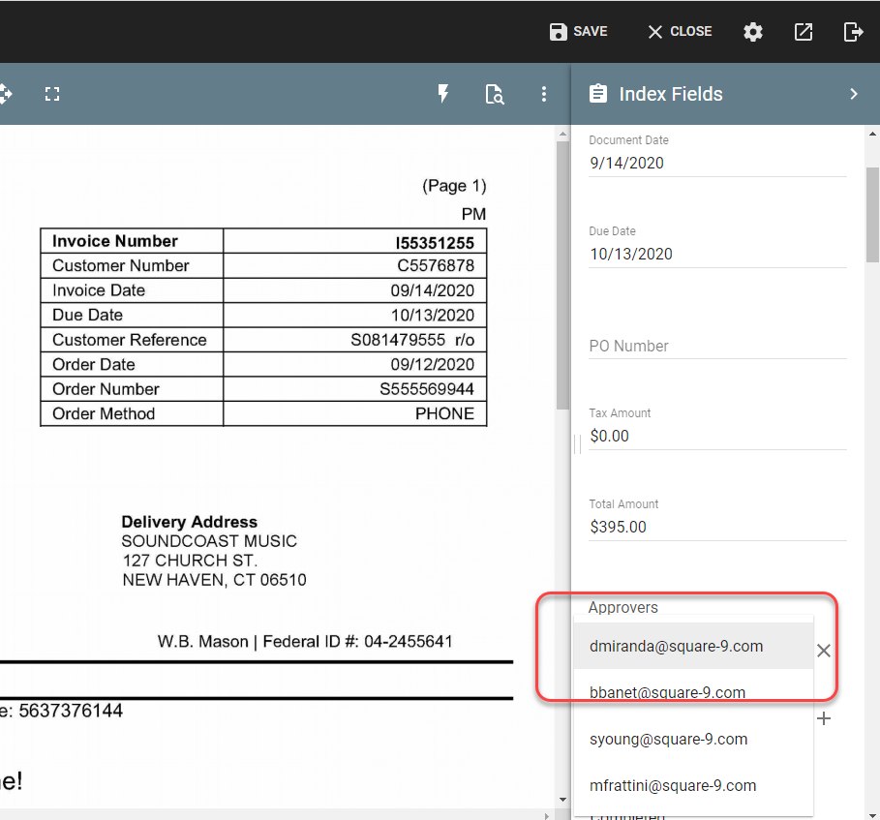
SELECT THE TRANSACTION AND ASSIGN THE APPROVER

Slide 14
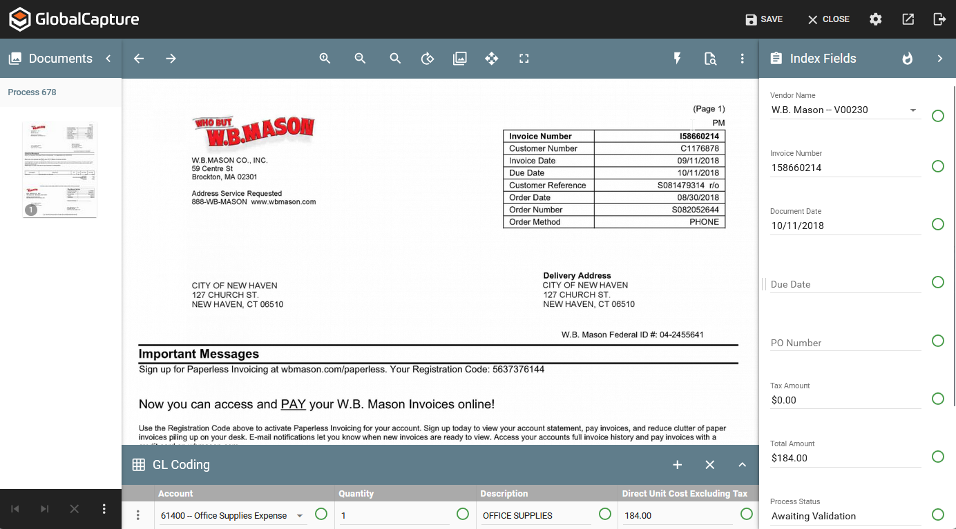
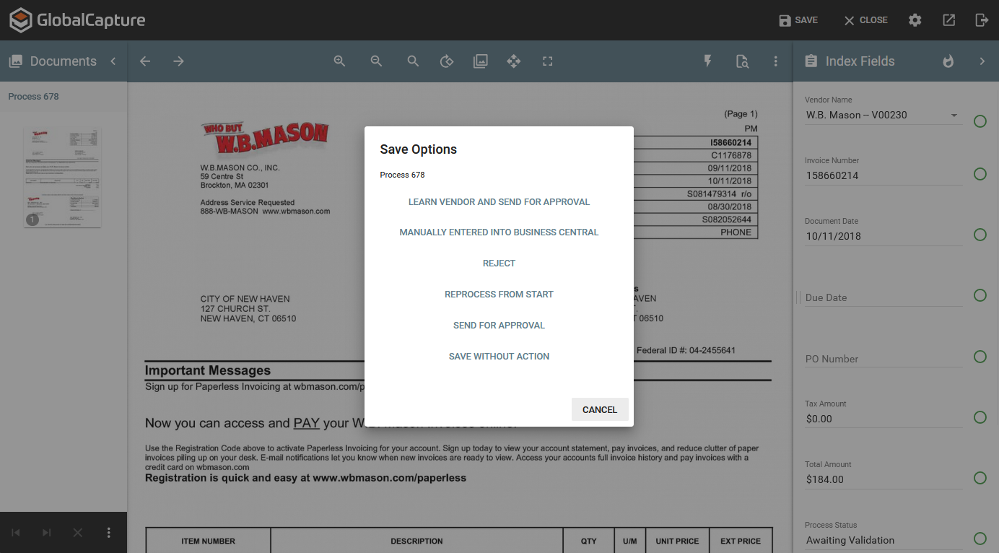
SAVE TO RELEASE FOR MANAGER REVIEW AND APPROVAL

Slide 15
Step 3 – Review And Approve
Review and take action on pending payable invoices

Slide 16
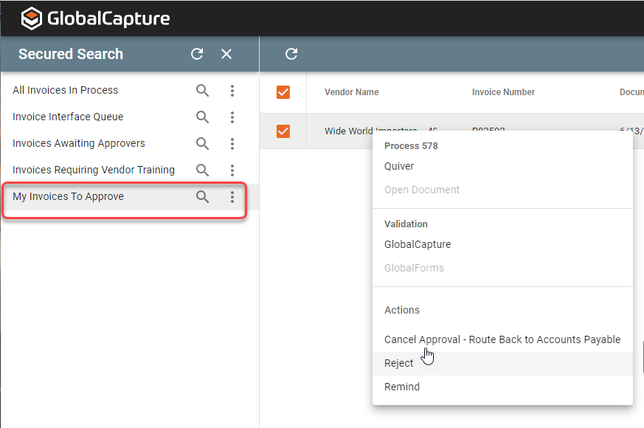
AVAILABLE VIA EMAIL NOTIFICATIONS OR WORK QUEUES

Slide 17
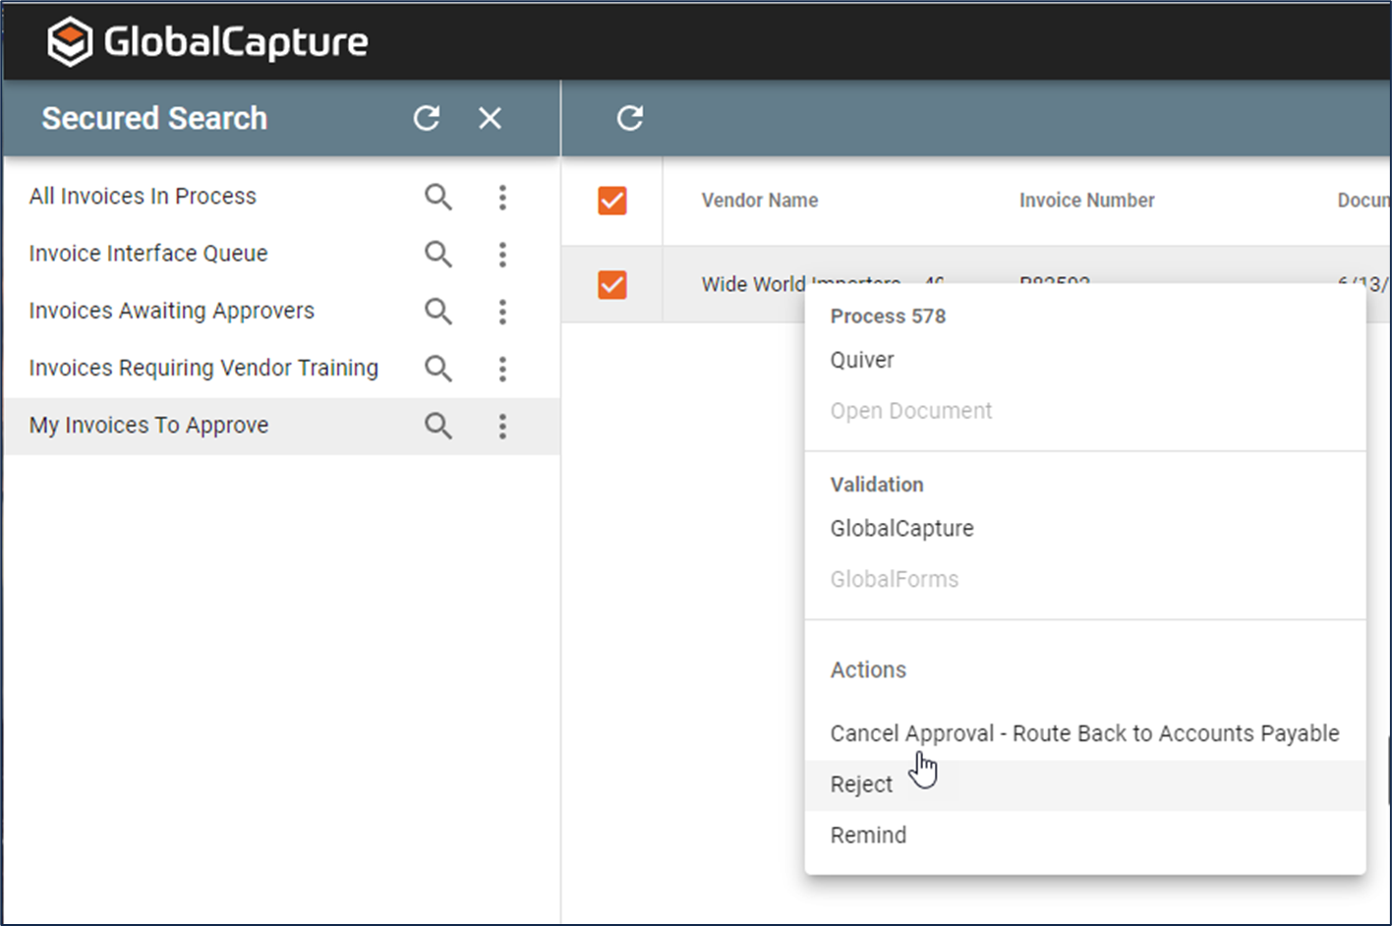
Managerial Approval
Simple and Secure Workflow Steps
Eliminate Delays
Approve Invoices For Payment
Reject Invoices For Payment
Remind Approver of a Pending Transaction
Cancel a Previous Action

Slide 18
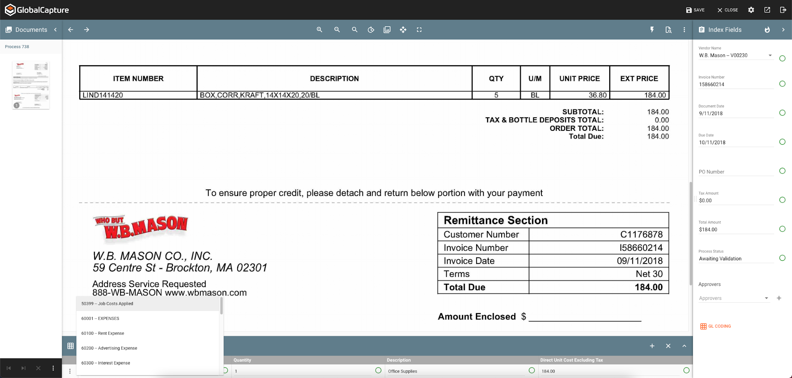
OPTIONAL GENERAL LEDGER CODING

Slide 19
Step 4 – Automated Payable Creation
No Code API Level Integration with Dynamics 365

Slide 20
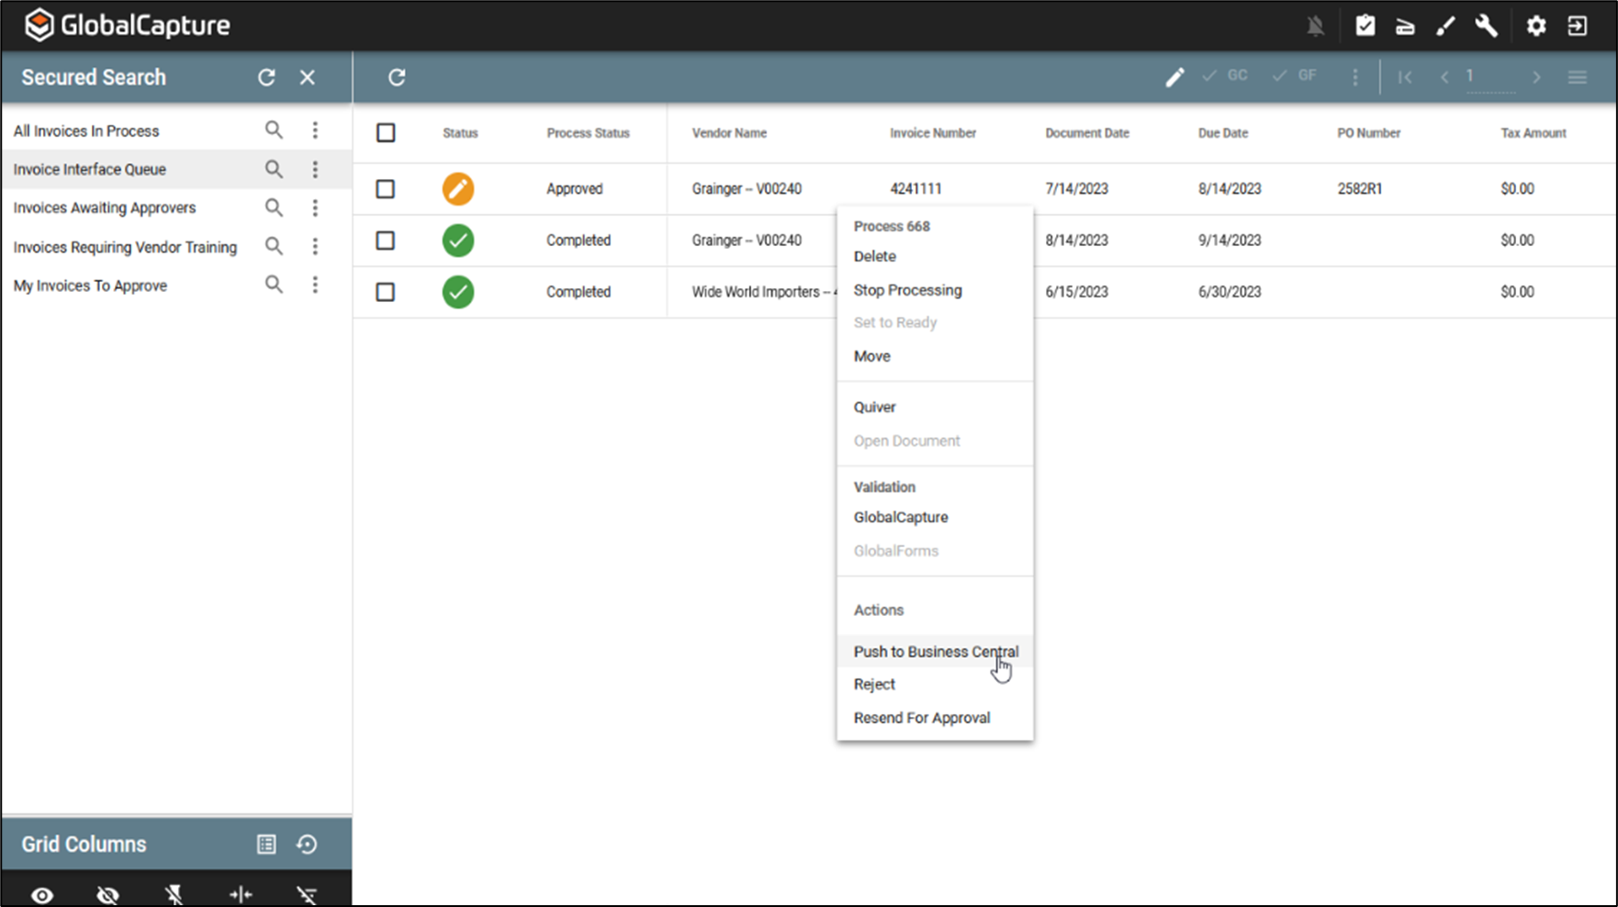
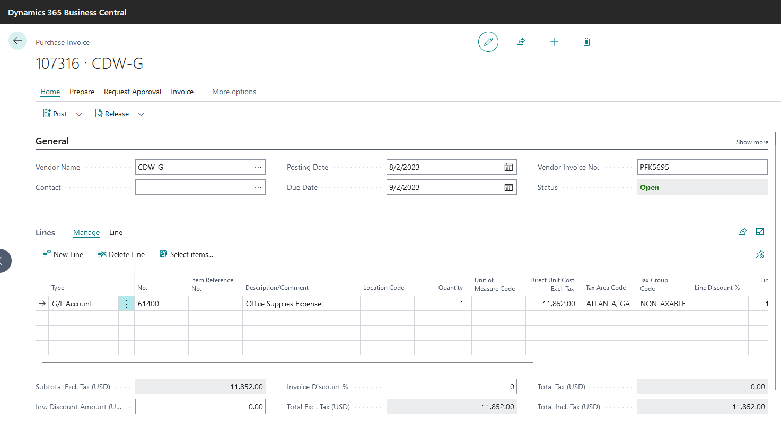
BIDIRECTIONAL DATA FLOW WITH GLOBALAUTOMATION

Slide 21
Step 5 – Image Archival
Keep Your Original Images To Reference As Needed

Slide 22
SAVE TO YOUR CHOICE OF IMAGE REPOSITORY
Square 9 GlobalSearch
Business Central Attachment
01
SharePoint
03
Google Drive
Citrix ShareFile
Notes:
Also have release to SFTP, FTP and JSON as additional options.

Slide 23
Standard Investment Breakdown
Complete Invoice Automation at Less than .084 Per Page

Slide 24
WHAT’S INCLUDED WITH DYNAMICS 365 GLOBALAUTOMATION
Square 9's AI-powered intelligent information platform allows you to:
Invoice Transformation – Using Square 9’s powerful AI engine, invoices arriving as Scans, PDF’s, Mail Attachment or imported digital files are transformed at both the header/footer and line-item level
Data Validation – Information extracted from the transformed Invoices can be validated through confidence-based reporting and/or visual validation.
Machine Learning – Vendor Names that do not match your vendor master list can be taught to use the correct naming convention going forward
Invoice Routing and Approval – disseminate invoices to managers for payment authorization through single or multi-level approval processes
General Ledger Coding – Using a synchronized list of general ledger accounts, the users can code the invoices at either the invoice or line item-level.
Automated Payable Invoice Creation – Once the invoice is approved and coded the data is simply released to Dynamics 365 Business Central to automatically create a pending payable invoice
Archival of the Transformed Image – With the Invoice Payable created, maintain a digital record of your invoices in the repository of your choice including the GlobalSearch IIM platform.

Slide 25
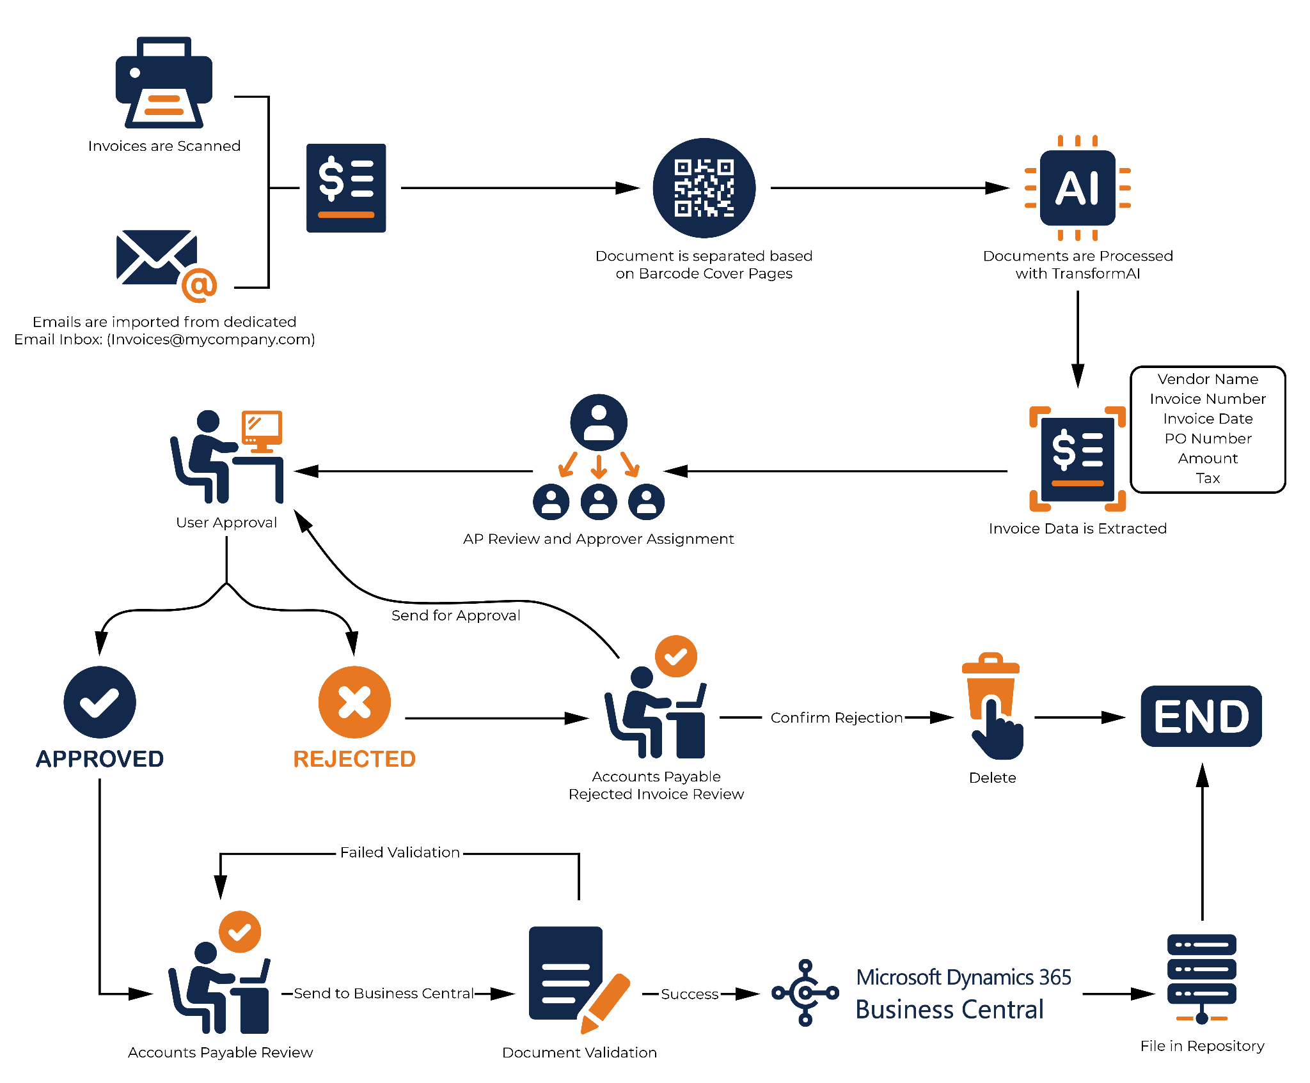
VISUALIZING THE GLOBAL AUTOMATION PROCESS
01
03
02

Slide 26
PRICING FOR DYNAMICS 365 GLOBALAUTOMATION FOR BUSINESS CENTAL
Dynamics 365 GlobalAutomation for Business Central |  | Up to 10 Names Users
GlobalAutomation |  | $10,150
Dynamics 365 Data Link |  | Included
Annual Investment in Invoice Automation |  | $10,150
Up to 10,000 invoices per month for less than $0.084 per page
Less than $4.87 per hour to process all your Payables*
*based on 52 forty-hour work weeks

Slide 27
STANDARD CONFIGURATION COSTS
Dynamics 365 GlobalAutomation for Business Central | Up to 10 Names Users
One Time Fixed Implementation Price | $4,500
Dynamics 365 Data Link Configuration | INCLUDED
Total Cost for Delivery and Configuration | $4,500
Includes standard workflow delivery and Integration with Dynamics 365
Custom Services Available at $1,750 Per Day

Slide 28
QUESTIONS

Slide 29
Office Address
127 Church Street
New Haven, CT 06510
E-mail Address
THANK
YOU
info@square-9.com
Website
square-9.com

