Slide 1
Square 9 Brand Book

Slide 2
Values

Slide 3
Mission Statement
Paper-based work is soul-crushing, profit-sapping, and an anchor on individual, team, and organizational productivity. Paper literally smothers innovation, creating a competitive disadvantage. Founders Stephen Young, Brian Banet, and Tony Bishop saw the potential for a new kind of software company focused on driving out paper-based inefficiencies in core business functions, and so Square 9 was born. From its days as an early incubator project in 2005 to its current position as a leading intelligent information management platform, we’ve never stopped innovating, and we never will.
More than 3,000 organizations in the U.S. rely on Square 9 to provide a platform for intelligent document capture, indexing, search integration, and business process automation. Let’s take the paper out of work together!

Slide 4
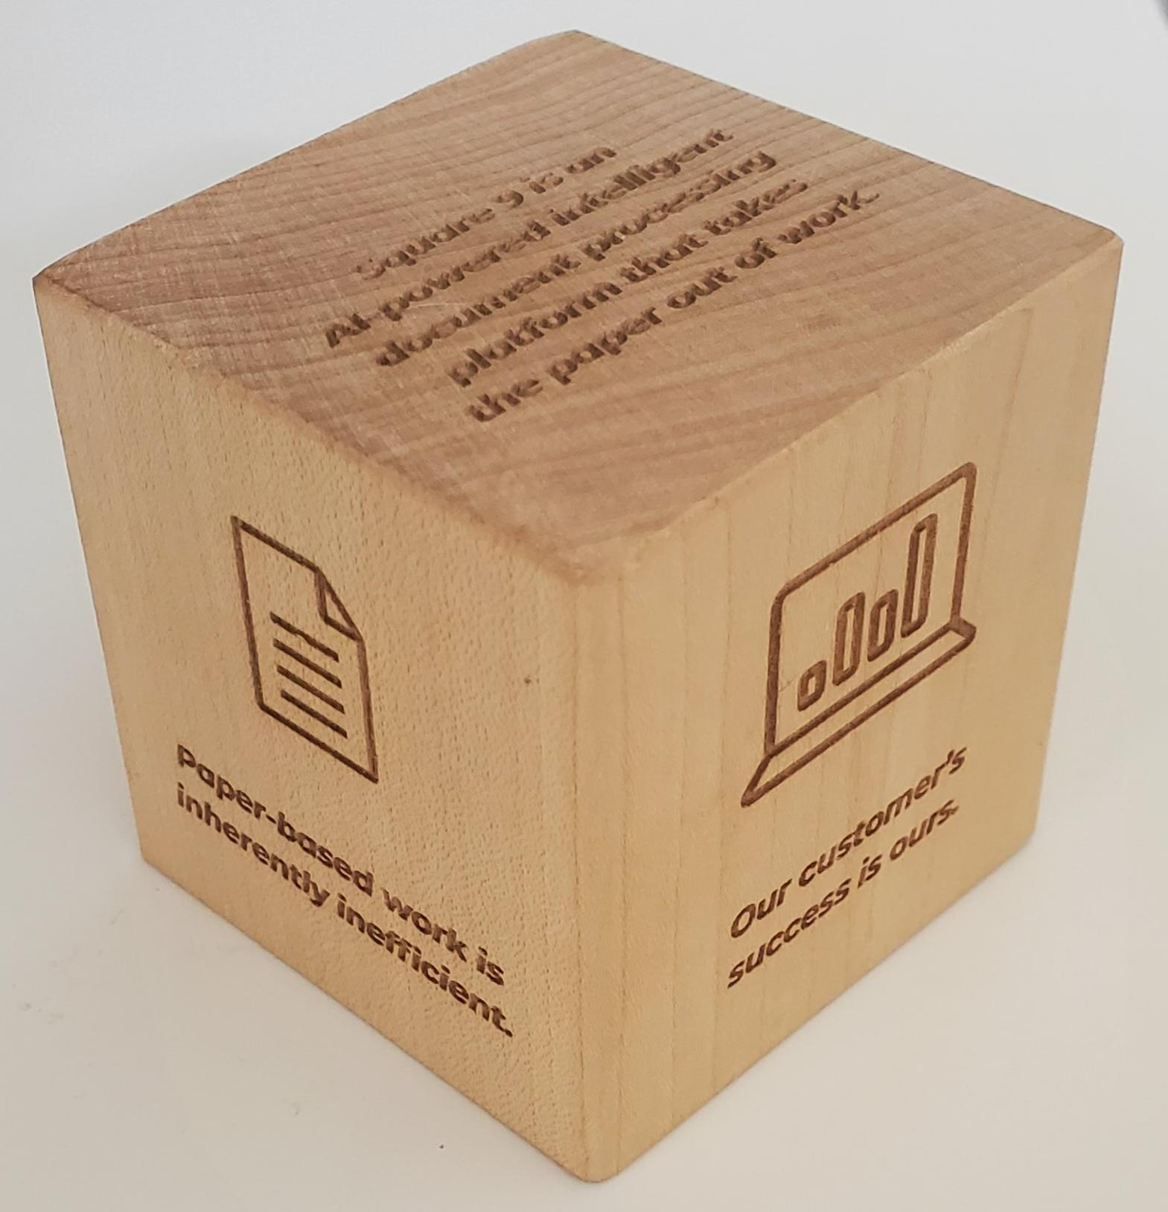
Brand Ethos
Square 9 is an AI-powered Intelligent Information Management platform that takes the paper out of work
We're here for the long term
Respect for employees, customers, and partners drives everything we do
Paper-based work is inherently inefficient
Our customer’s success is ours

Slide 5
Writing Style

Slide 6

Brand Voice
The Square 9 AI-powered intelligent information management platform takes the paper out of work and makes it easier to get things done with digital workflows that automate many aspects of how you work today. We make it easy by extracting information from scans or PDFs, storing documents in a searchable archive, and building digital twins of your current processes through graphical workflows.
Tone:
Modern
Reliable
Concise
Innovative
Relatable
Capable
Creative

Slide 7
Writing Style
“Intelligent Information Management Platform”
Take the Paper Out of Work
AI-Powered Platform
Searchable Document Archive
Digital Workflows

Slide 8
Social Media Best Practices
Square 9 Social Media Accounts
  Linkedin - Square 9 Softworks
  Facebook
  Twitter (X) - @S9Softworks
We believe Square 9 employees can be brand ambassadors
Square 9 encourages employees to follow our official social media accounts and share posts from those accounts
Only use Square 9 logos outlined in this brand book
DON’T engage with competitors or customers in an inappropriate way
DON’T share sensitive information relating to customers, Square 9, and other employees

Slide 9
Logos

Slide 10

Primary Logo
The Square 9 logo has two components - the designator and the logotype. The designator must be used as part of the logo in all communications. Our logo is designed to visually and symbolically express our brand. Altering our logo can weaken our brand.

Slide 11



Alternative Logos
The logo can only be displayed in Square 9 orange and navy, orange and white.

Slide 12




Alternative Logos for Small Images and Apparel
Used for graphical images where the logo is too small and the tagline cannot be read. Also used for t-shirts, polos, button-downs, etc. The logo can only be displayed in Square 9 orange and navy, orange and white.

Slide 13

Logo / Prohibited Use
Below are examples of Square 9 logos that are misused or missing elements. Please defer from using these examples.
Absence of Designator
Use of Different Color
Absence of Designator and Softworks
Displayed Vertically

Slide 14

Logo / Co-Branding
When co-branding with Reseller partners, as a general rule, both logos should appear in conjunction with, and be similar in size as, the partner brand. Enough distance is required to clearly show that each partner companies are different entities. If not in conjunction, the same rules of sizing should still apply. For all co-branded material, the Square 9 authorized Reseller logo should be used.

Slide 15
Typography

Slide 16
Typography
The typeface for copy and communications, marketing, heading, and graphics purposes are below:
Monsterrat | Montserrat Medium | Montserrat Semibold

Slide 17
Color Palette

Slide 18
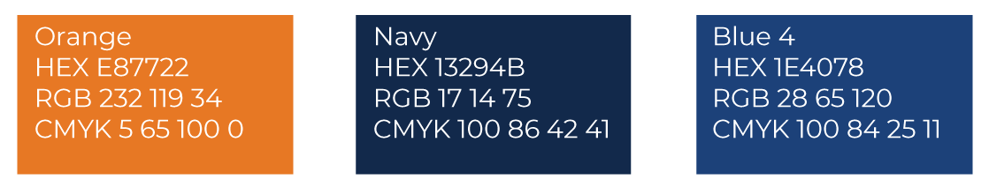
Brand Color Palette
The primary colors are navy and orange. These are the main colors that are core to Square 9’s brand and identify the company logo. In addition to the navy and orange, Square 9 may utilize blues that should be used as a complement to the main brand colors in design elements.

Slide 19
Iconography & Images

Slide 20
























Iconography

Slide 21





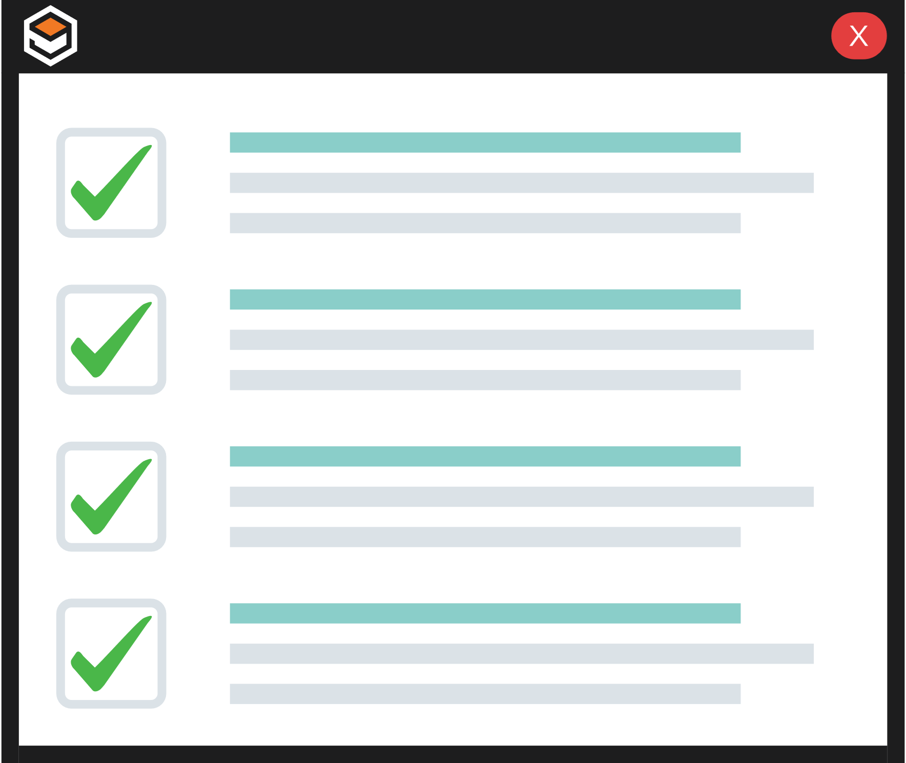

Brand Images

