Slide 1
Taking the Paper
Out Of Work
Stephen Young | President/CEO

Slide 2
01
02
03
What is Intelligent Information Management
Who We Are
Go To Market Strategy
Agenda
04
05
06
Product Review
Resources
The Reseller Program

Slide 3
What is Intelligent Information Management?

Slide 4



What is Intelligent Information Management?
Transform
Identifying inefficient paper-based processes and digitizing them for greater downstream effectiveness
Secure & Protect
Securing and encrypting information so it’s available only to the right people at anytime from anywhere regardless of location
Automate
Putting digitized information into motion while enforcing business rules for approvals, notifications, decision-making, and for sharing with other applications

Slide 5
Who We Are

Slide 6



Who We Are
Square 9’s AI-powered intelligent information management platform eliminates paper from your processes, automates workflows, and adapts to your unique needs to maximize your investment.
From Accounts Payable automation to HR automation, business process automation, and beyond, we work the way you do and make it effortless to:
Extract your information using generative AI
Capture additional data through customizable web forms
Integrate and share captured data with Dynamics 365 and other business applications
Maintain secure, searchable digital records archives
Automate processes with intuitive workflows
Notes:
Paper-based processes are more than inconvenient—they drain productivity, stifle innovation, and limit your team’s potential to excel. Square 9’s AI-powered intelligent information management platform eliminates paper from your processes, automates workflows, and adapts to your unique needs to maximize your investment. From Accounts Payable automation to HR automation, business process automation, and beyond, we work the way you do and make it effortless to:
Extract your information with precision AI
Integrate and share captured data across your essential business applications
Create secure, searchable digital archives
Automate processes with intuitive workflows
Take the paper out of work. Transform how you work so your team is empowered to focus on what matters most, driving productivity and innovation in a digital-first world.

Slide 7
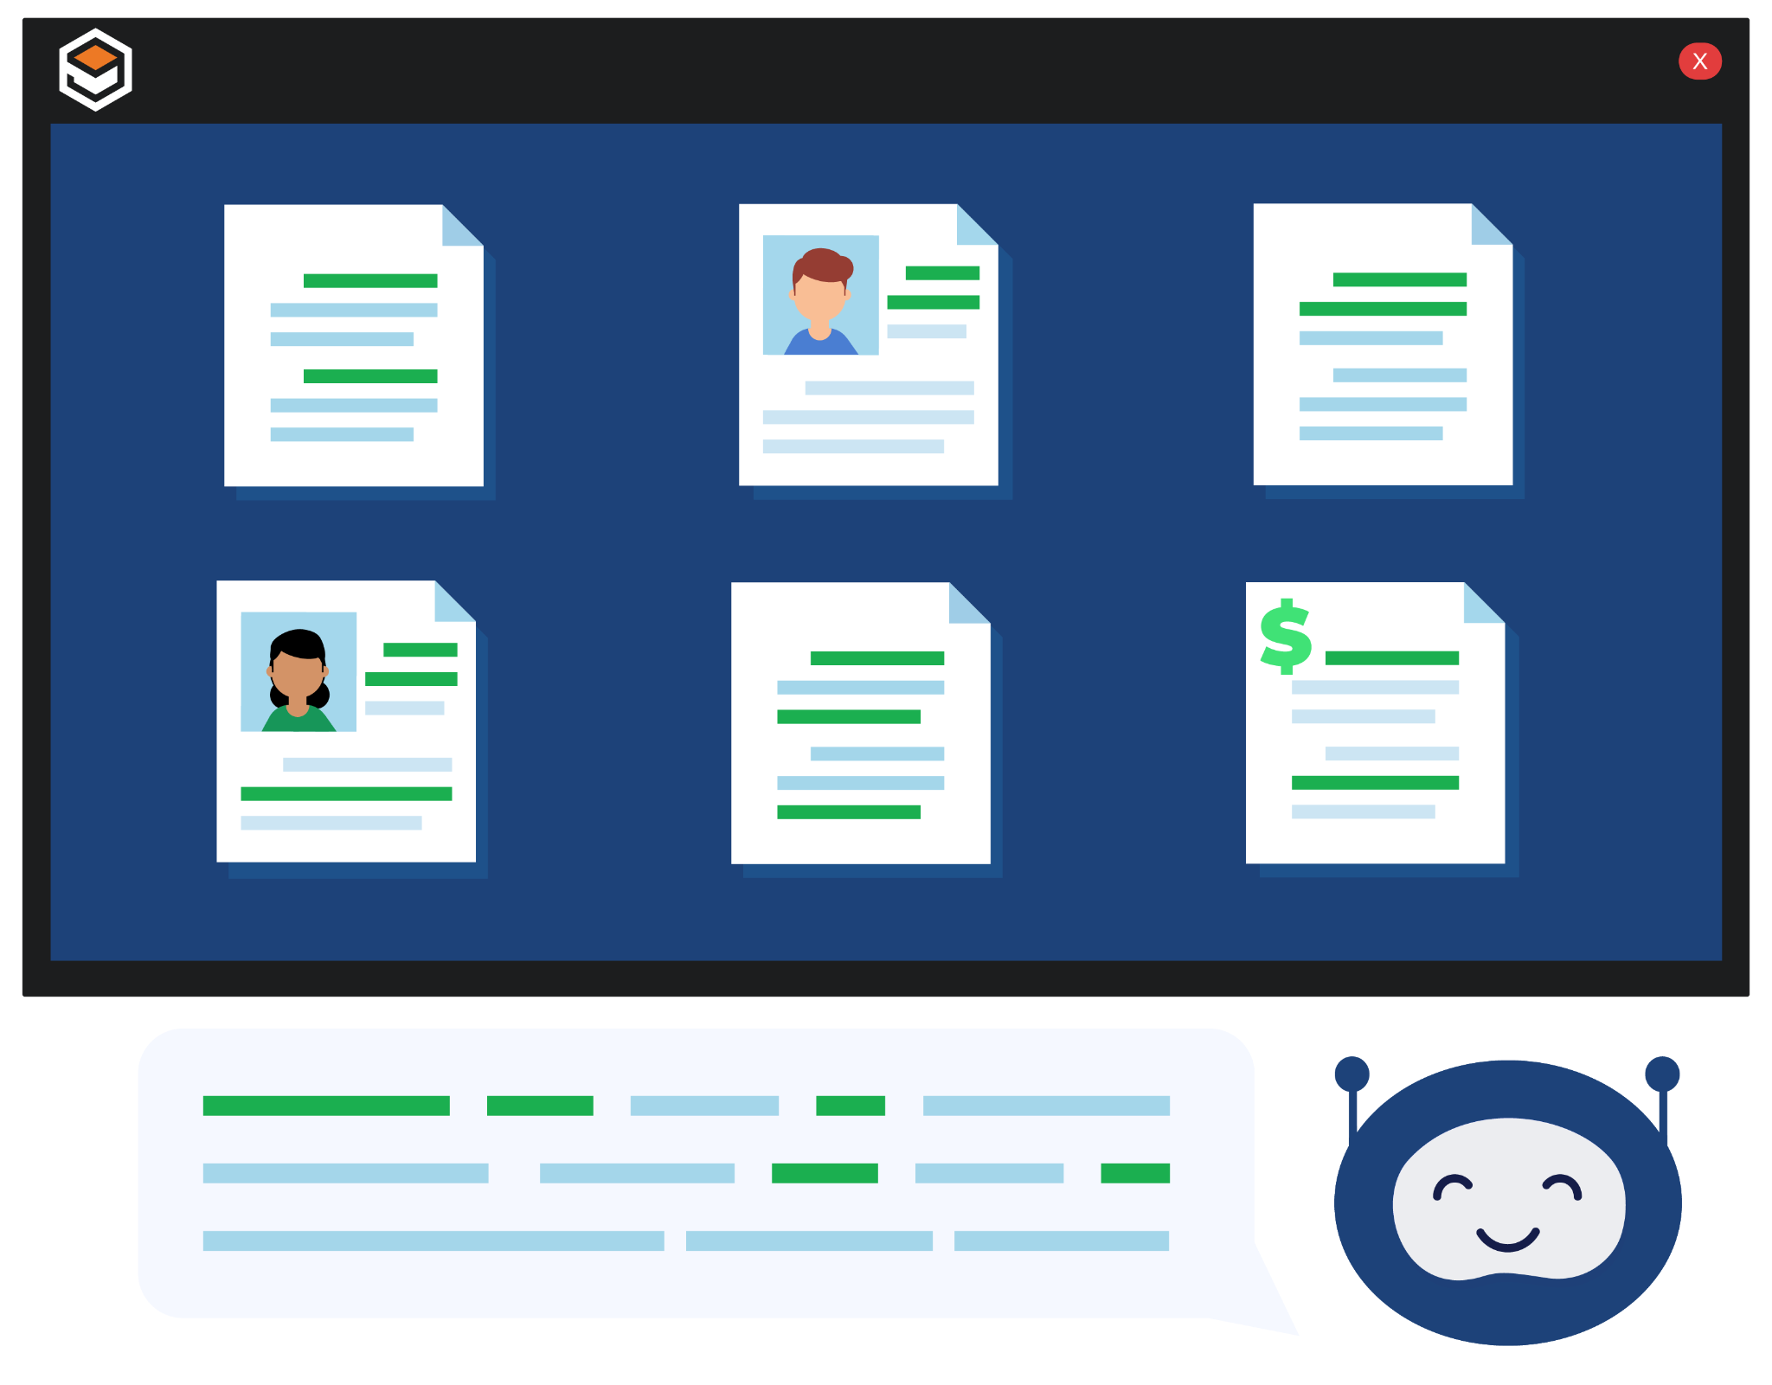
Unlocking Information:
Access Before Management
Before You Can Manage Information, You Need to Access It
With our Generative AI, we take information and put it into motion extracting key data from any source: Documents, emails, invoices, contracts, and more.
AI-driven data access – Instantly extract and unlock critical business information
Seamless integration – Ensure the right data flows into your workflows
Notes:
Our Intelligent Information Management platform is only as powerful as the data it can work with. That’s why access to the data comes first.

Slide 8




The Square 9 AI-Powered Intelligent Information Management Platform
AI Driven Data Extraction
Business Process Automation
Fast and accurate document capture and imaging to make locating information easy
Workflow automation to keep information moving throughout your organization
Document Management
Web Forms Design
Secure access, storage and retrieval of business-critical documents
Dynamic web forms for easy capture and routing of information
Notes:
Our platform for intelligent information management consists of four primary practice areas.
- It starts with the ability to extract valuable information from documents or collect data through the use of web forms.
- We then put that information into motion through a powerful business process automation engine that allows it to flow through your organization where it’s reviewed, approved or escalated as needed.
- Finally, your information is made accessible from anywhere at anyime through a web based content repository that is SOC 2 and HIPAA compliant to ensure your information is secure.

Slide 9
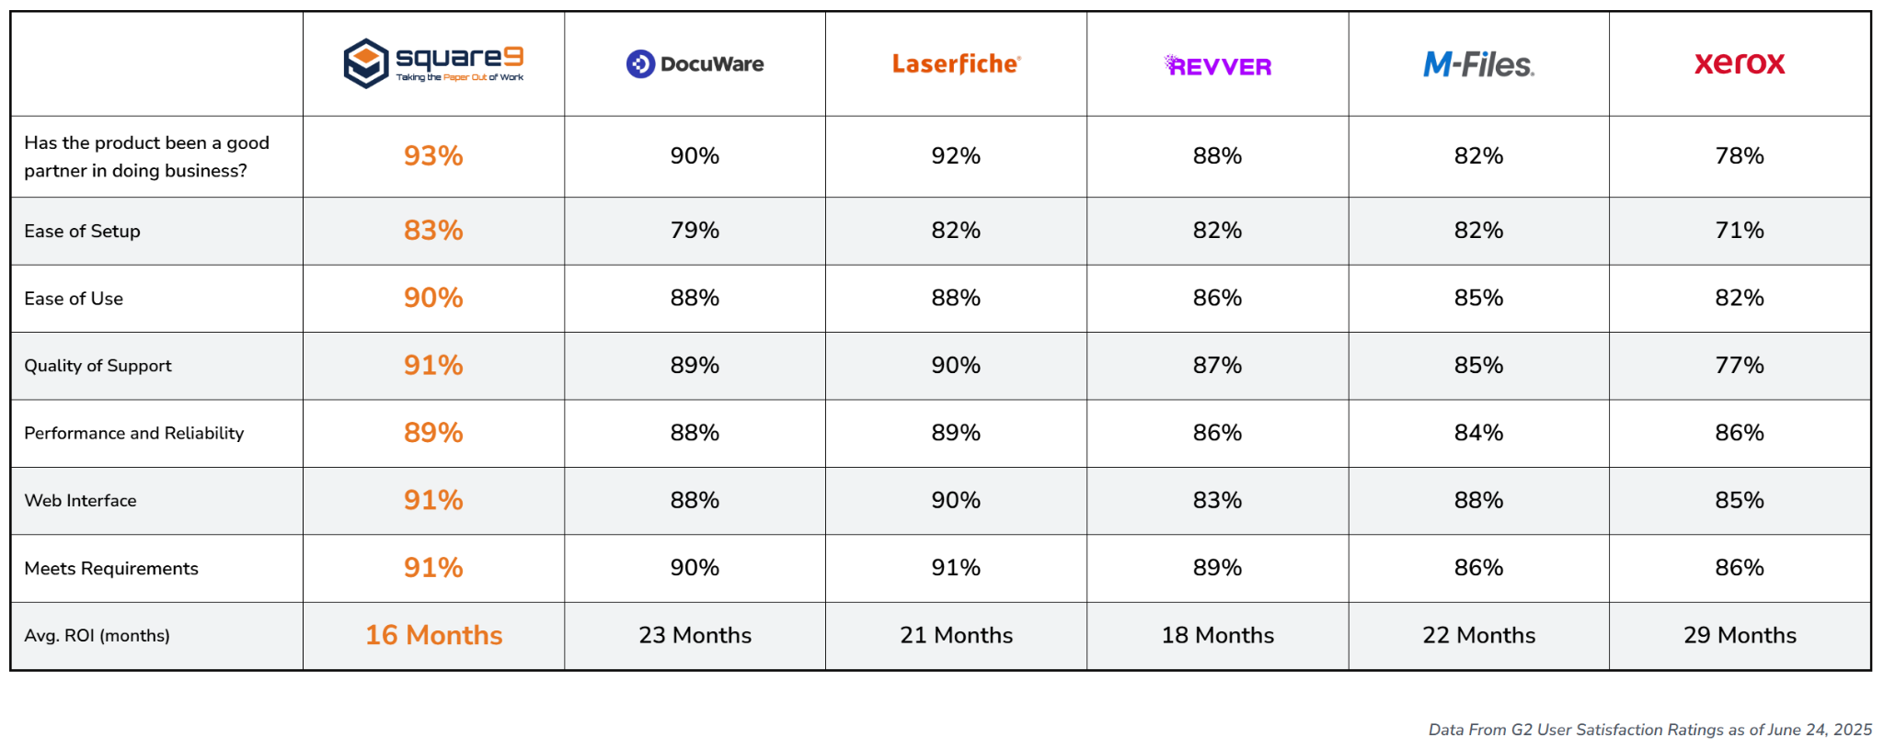
Recognized As The Industry Leader
Notes:
At Square 9, we believe in complete transparency during the evaluation process. We believe there are key differentiators that set us apart and we actively solicit independent reviews to understand what we do well and where we can improve. What you’re seeing here is publicly available at G2, a Gartner company which shows how Square 9 has been rated against our most common competitors.
While it’s great to be rated highest in so many categories, my attention immediately goes to the Average Return on Investment which is rated at 20% our nearest competitors.
Another important differentiator is that as a platform, Square 9 provides and end to end solution for your needs at about the same price as other products that require third party products to achieve the same results. That includes features like true AI driven data extraction and iPaaS integration capabilities for connecting to your line of business applications.

Slide 10
Where We Can Help
Human Resources Automation
1
3
From onboarding to their final day on the job, Square 9 manages the flow of employee information. With web forms to capture critical data and a SOC 2 and HIPAA compliant repository for secure access, we documents their journey every step of the way.
Accounts Payable Automation
Contract Management
2
With AI driven data extraction, Square intelligently handles every task along the AP path including the hands-off generation of an approved bill in your accounting or ERP solution.
It’s time to start digitally, protecting the flow of information where you’re are most vulnerable to risk. Square 9 will ensure you’re working with the correct version while managing expirees and renewals for you automatically.
Notes:
At Square 9 we can digitally transform virtually any business process, whether it’s industry specific or a more generalized practice area.
Hands down, Accounts Payable is where we typically get started. In fact roughly 80% of our new customers start in this area and for good reason. A strong, provable ROI that guarantees a big win for your first project makes it an ideal place to start.
Another favorite is Human Resource Automation where we can transform not only your onboarding process but also you ongoing employee management. With HR departments being asked to do more with less resources, this is a practice area that many companies explore early on.
Finally, contracts management is another high demand area. With document distribution, version control, routing and approval automation and digital signature integration through DocuSign, there is enormous opportunity for process improvement.

Slide 11
Go To Market Strategy

Slide 12

Square 9’s Go To Market Strategy
Growing Reseller Profitability Requires More Than Just a Strong Product
Unparalleled Pre-Sales and Post Sales Support Programs
In House Professional Services with Delivery Guarantee
Easily adopted Solutions that deliver rapid ROI
Free online education program
Square 9 sets itself apart through a unique level of products, service and support.

Slide 13
Product Review

Slide 14
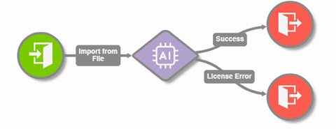
Generative AI Data Extraction
InquireAI inserts a ChatGPT type of experience into your Automated Document Processing (ADP) Workflows allowing you to extract information simply by asking for it
Uses simple, natural language prompts
Requires no extensive training or product knowledge.
Far Greater Flexibility than even LLM AI Models
Allows you to contextually summarize the document
Works on both printed and handwritten information.

Slide 15
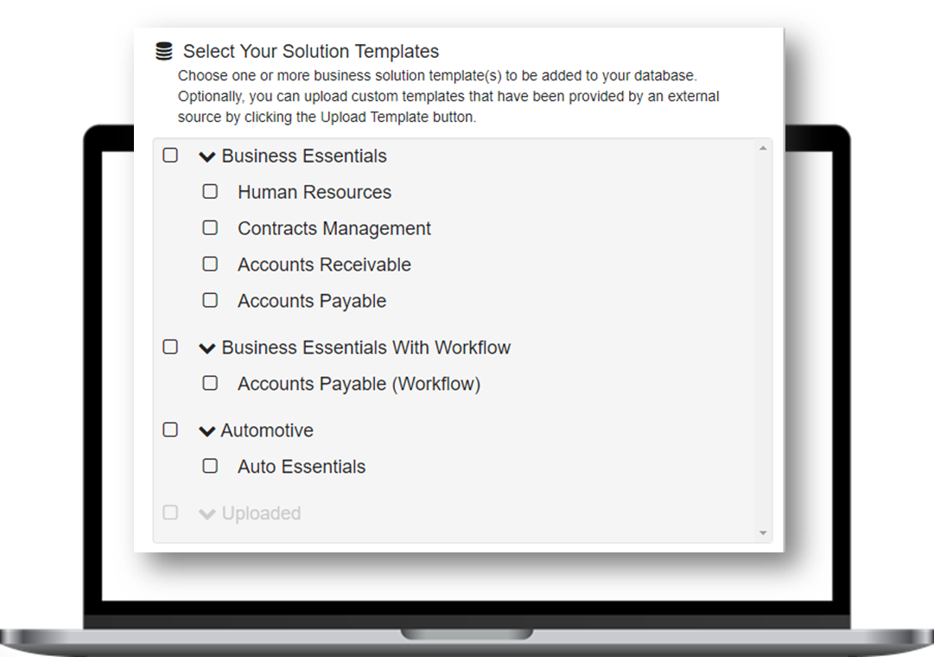
The Solutions Delivery Network
Simplifies the capture, retrieval, organization, and distribution of business information while improving productivity.

Slide 16
Business Essentials
Available through the Solutions Delivery Network
Addressing areas common to every business that benefit from ECM automation
Accounts Receivable
Accounts Payable
Contracts Management
Human Resources
Ranging from $126 - $375 per month for three concurrent users depending on the required level of automation.

Slide 17
Resources

Slide 18
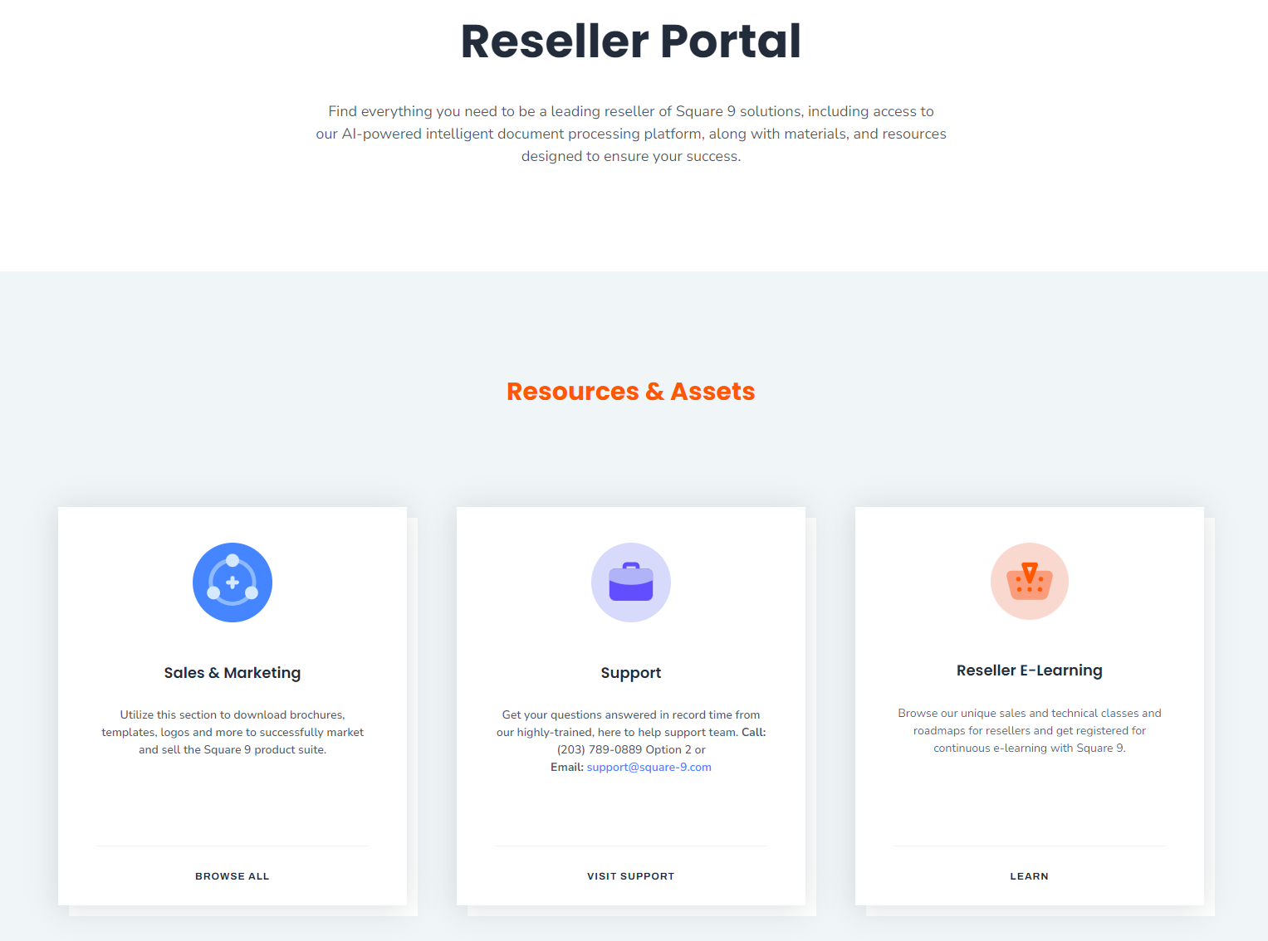
Reseller Portal
Square 9’s Reseller Portal houses a variety of marketing materials including battle cards, brochures, presentations, and proposals to help you drive business growth.

Slide 19
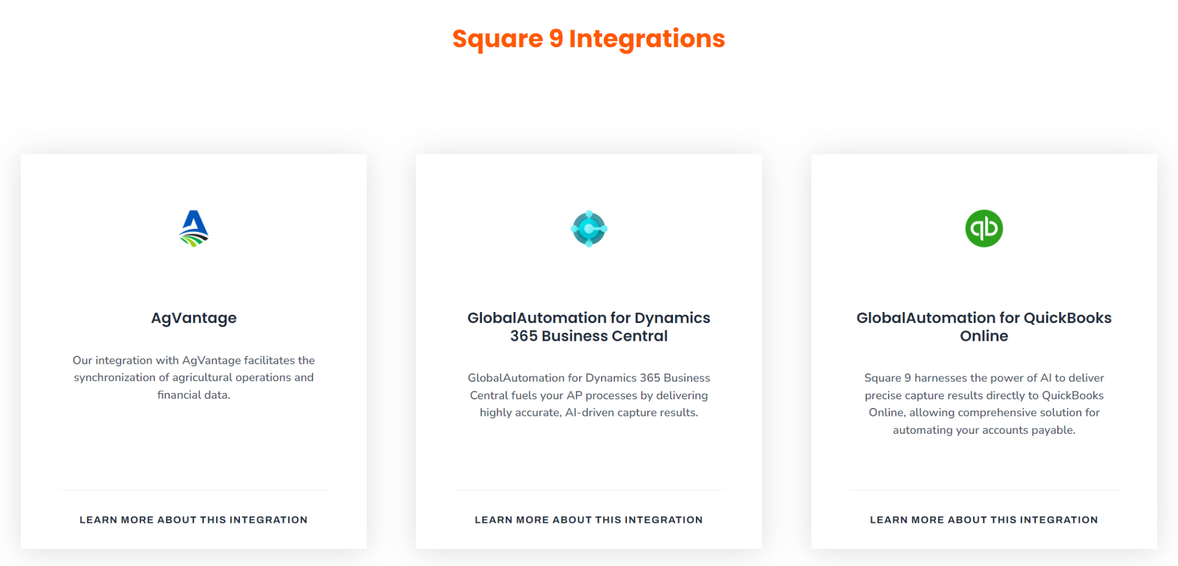
Integrations Page
Square 9 integrates with top business solutions. All these are listed on the integration page with details how our integrations with these platforms help improve your customers’ business processes. Some of Square 9’s integration pages are:
AgVantage
GlobalAutomation for Dynamics 365 Business Central
GlobalAutomation for QuickBooks Online
NetSuite
PDI

Slide 20
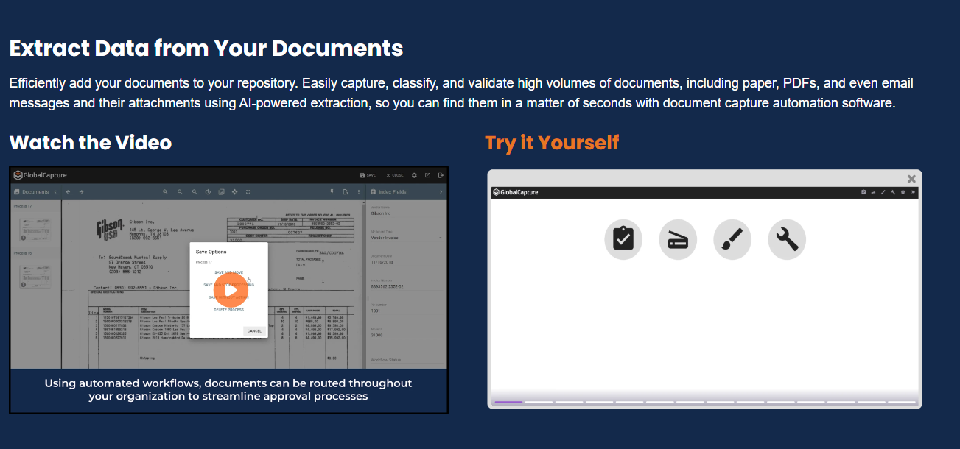
Interactive Demos
Square 9’s Product Library offer free to use guided tours through the Square 9 Platform including:
Document Capture Automation
Enterprise Content Management
Web Forms
Additional demos are geared toward integrations and departments :
GlobalAutomation for MS Dynamics 365 Business Central
GlobalAutomation for QuickBooks
HR Onboarding

Slide 21
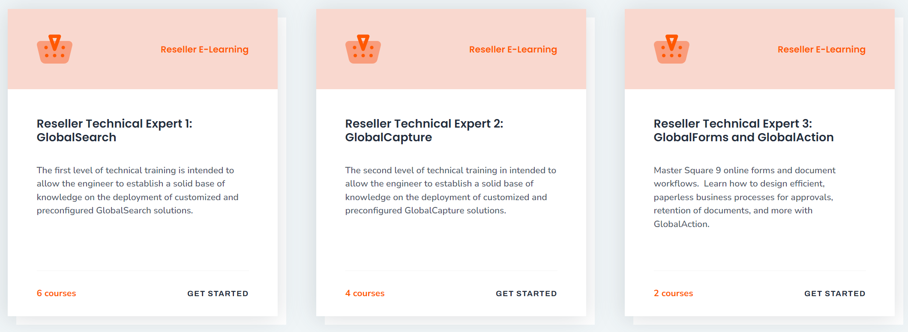
Reseller E-Learning
Customized learning tracks for Reseller Technical Professionals or Sales Professionals will help you learn how to design and manage solutions or uniquely convey the Square 9 platform’s value proposition.

Slide 22
The Reseller Program

Slide 23




Partnering with Square 9
Ensure Project Success. Grow with Confidence.
Annual Recurring Revenue: Grow steady revenue with Square 9’s AI-powered platform.
Sales Team Extension: Leverage our experts across products, industries & departments to drive growth.
In-House Services: Deliver expert setup, support & customization for faster ROI.
Seamless Integration: Connect clients’ systems effortlessly with our iPaaS platform.
Notes:
Annual Recurring Revenue: Build a steady stream with Square 9’s AI-powered Intelligent Information Management Platform
Extension of Your Sales Team: Gain access to our dedicated team of knowledgeable professionals who work with you across products, industries, and departments to support your growth efforts.
In-House Professional Services: Offer Your clients expert assistance with setup, support, and customization with an in-house team of project managers and experience faster ROI on Projects
Onboard iPaaS Integration: Seamlessly integrate your clients’ existing systems for a smooth onboarding process with our own iPaaS platform, which allows you to connect to popular applications like Microsoft Dynamics, and many more.

Slide 24
The 2025 Reseller Program
Three Benefit Levels
Ranging from Limited Commitment to Maximum Return
1.
Business Partner
2.
Authorized Partner
3.
Elite Partner

Slide 25
Objectives
Provide full participation in ARR for all Resellers regardless of their level of commitment
Allow Smaller Resellers to Grow Their ECM Practice Over Time
Eliminate the cost of staffing a support desk for our Resellers by Offering a Direct Support Model
Give Resellers the Opportunity to use Square 9 Products in the Cloud at little or no cost
Empower fully committed resellers with the opportunity to maximize their margins

Slide 26
Business Partner Level
No commitment
No reseller fee
No Minimum Activity Requirement
No Revenue Targets
No Training Requirements
20% On Software and Subscriptions
20% On Professional Services
20% On Subscription Renewals
No Help Desk Responsibilities
All Support Provided by Square 9
Unlimited Access to Demonstration Software

Slide 27
Authorized Partner Level
$3,500 Annual Fee
Earn back 50% of the Annual Fee with 25K in Sales
Earn back 100% of the Annual Fee with 50K in Sales
New Opportunity Minimum of 25 per year
Sales Level I Training Required
No Technical Certification Required
40% on Software and Subscriptions
20% on Professional Services
20% On Subscription Renewals
All Support Provided by Square 9
Access Square 9’s entire suite of products at no cost for their internal use.
  GlobalSearch Cloud Enterprise Essentials with 15 Named Users
  InquireAI (Up to 500 pages per month, volumes over 500 the dealer is required to purchase Production InquireAI)
  Unlimited GlobalCapture Volumes
  Unlimited GlobalAction Workflows
  Unlimited GlobalForms Workflow Licenses
  Valued at $15,000/Year

Slide 28
Elite Partner Level
Annual Renewal Fee Waived
Revenue Requirement of $100K per year
New Opportunity Minimum of 40 per year
Minimum Support Deck of 20 Customers
Sales and Technical Training Requirements
Annual Recertification Required
40% on Software and Subscriptions
20% on Professional Services
40% On Subscription Renewals
Partner Provides Level 1 Support
Access Square 9’s entire suite of products at no cost for their internal use.
  GlobalSearch Cloud Enterprise Essentials with 15 Named Users
  InquireAI (Up to 500 pages per month, volumes over 500 the dealer is required to purchase Production InquireAI)
  Unlimited GlobalCapture Volumes
  Unlimited GlobalAction Workflows
  Unlimited GlobalForms Workflow Licenses
  Valued at $15,000/Year

Slide 29
Q&A

Slide 30
Thank You
(203) 789-0889
info@square-9.com
square-9.com

