Slide 1
Your Square 9 Digital Transformation Journey
Project Overview and Next Steps
Date
© 2025 Square 9. All Rights Reserved.

Slide 2
Introductions

Slide 3
Agenda
1.
2.
3.
4.
Overview of Challenges
Proposed Solution
Statement of Work Review
Closing, Next Steps and Questions
A brief summary of the challenges outlined that will be addressed in this project.
Step by step overview of the solution we are proposing along with a product tour.
Line by line review of the SOW to ensure expectations are fully aligned.
What remains before we can finalize the project and move forward?

Slide 4




Overview of Challenges
Building a mutual set of expectations for your digital transformation journey.
Challenge #1
Brief overview
Challenge #2
Brief overview
Challenge #3
Brief overview

Slide 5
Proposed Solution
Our Solution solves your challenges by:
Challenge #1
Solution #1
Challenge #2
Solution #2
Challenge #3
Solution #3
Notes:
Getting data from GlobalAutomation to your financial system of choice will depend on it’s import capabilities.
- for products using a modern REST API we offer a direct iPaaS integration
- for systems that rely on database to database integration we can provide scripting of SQL stored procedures
- and for some systems that have their own mechanisim for import we can provide you with a standard CSV file for import.
Which approach we select will depend on your system and it’s preferred method for accepting data.

Slide 6
Statement of Work Review

Slide 7
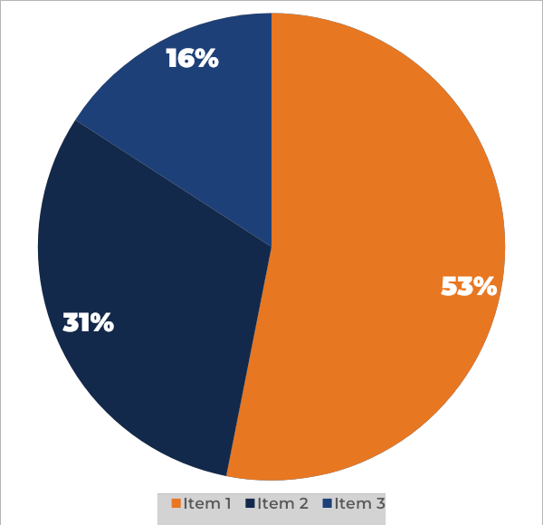
ROI Metrics
Use this slide to outline important metrics that will be improved by the execution of this project.
53%
Reduction in the cost to process an invoice
31%
Improvement in overall AP FTE efficiency
16%
Estimated portion of invoice volume that will require manual entry

Slide 8
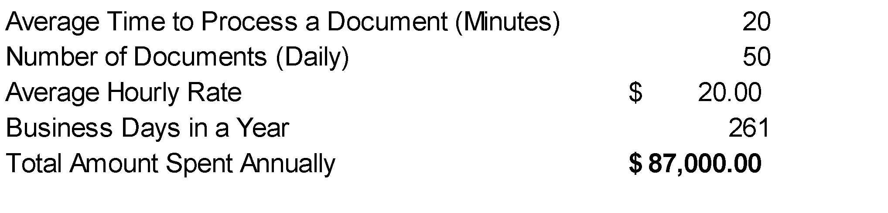
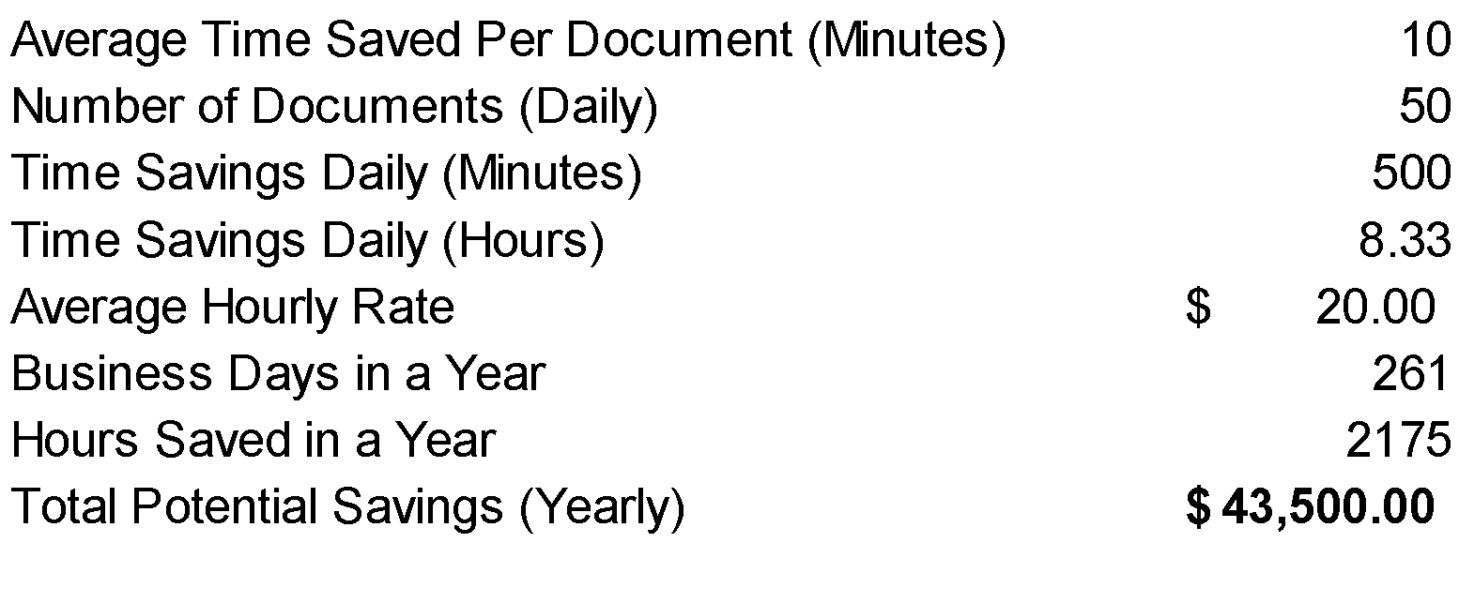
ROI Metrics
This is an alternate slide to show metrics around the ROI for our software.
2,175
Hours Saved (Yearly)
$20/Hour
Average Employee Cost
$43,500
Estimated Annual Savings
Notes:
This is an alternate slide to highlight metrics.

Slide 9














The Square 9 Pedigree
These are all based solely on customer reviews - they tell our story for us. We'd love for you to come join them.

Slide 10
Recognized As The Industry Leader
Criteria | Square 9 | DocuWare | Laserfiche | M-Files
Onboard iPaaS Integration | Included | X | X | X
Has the product been a good partner in doing business? | 93% | 90% | 92% | 82%
Ease of Setup | 83% | 79% | 82% | 82%
Ease of Use | 90% | 88% | 88% | 85%
Quality of Support | 91% | 89% | 90% | 85%
Performance and Reliability | 89% | 88% | 89% | 84%
Web Interface | 91% | 88% | 83% | 88%
Meets Requirements | 91% | 90% | 91% | 86%
Avg. ROI (months) | 16 Months | 23 Months | 21 Months | 22 Months
Data From G2 User Satisfaction Ratings as of June 24, 2025
Notes:
Authenticity
At Square 9, we believe in complete transparency during the evaluation process. We believe there are key differentiators that set us apart and we actively solicit independent reviews to understand what we do well and where we can improve. What you’re seeing here is publicly available at G2, a Gartner company which shows how Square 9 has been rated against our most common competitors.
While it’s great to be rated highest in so many categories, my attention immediately goes to the Average Return on Investment which is rated at 20% our nearest competitors.
Another important differentiator is that as a platform, Square 9 provides and end to end solution for your needs at about the same price as other products that require third party products to achieve the same results. That includes features like true AI driven data extraction and iPaaS integration capabilities for connecting to your line of business applications.

Slide 11
Project Investment

Slide 12
Project Investment
Below are the costs for this solution.
Licensing Description
Placeholder Licenses | $X
Placeholder for Maintenance | $X
Licensing Options
1 Year Investment | $X
Professional Services
One Time Labor Cost | $X
Initial Project Investment | $X
Annual Recurring Costs | $X
Time to ROI | X Months
Notes:
Modify this as you see fit. Included is a line to compare and highlight a ROI if tangible.

Slide 13
Thank You!
455-5678-2233
info@square-9.com
www.square-9.com
© 2025 Square 9. All Rights Reserved.

