Slide 1
Managing Information Can Be Hard
We Make it Easy
Intelligent Document Processing

Slide 2
Agenda
01
What is Intelligent Information Management
04
Product Review
02
Who We Are
05
Resources
Go-To-Market Strategy
03
06
The Reseller Program

Slide 3
What is Intelligent Information Management?

Slide 4



What is Intelligent Information Management?
Transform
Identifying inefficient paper-based processes and digitizing them for greater downstream effectiveness
Secure & Protect
Securing and encrypting information so it’s available only to the right people at anytime from anywhere regardless of location
Automate
Putting digitized information into motion while enforcing business rules for approvals, notifications, decision-making, and for sharing with other applications

Slide 5
Who We Are

Slide 6




Who We Are
Square 9 Softworks is a generative AI-powered platform that removes the frustration of extracting data from documents, forms, and all external sources, so you can harness the full power of your information. Release your team from repetitive tasks while your work flows freely to accelerate your decisions and actions.

Slide 7

Unlocking Information Access
You Need to Be Able to Access Information Before You Can Manage It
With our AI-driven platform we identify the information you need by extracting high value data from any source: Documents, emails, invoices, contracts, and more
AI-driven Data Access
Instantly extract and unlock critical business information.
Powerful Business Process Automation
Putting your information in motion for routing and approvals.
Seamless API integration
Eliminate data silos by ensuring data can be easily shared with other business applications.
Notes:
Automating accounts payable and receivable requires fast access to information like vendor names, payment due dates, proof of purchase, and more.
Much of this data is still located on paper documents for many organizations, and even those trying to digitize often have to deal with spotty accuracy, costly implementations, and a need for technical expertise.
By combining generative AI-powered capture with powerful no-code workflows and near limitless integration options, this information can be captured and routed effortlessly for more efficient processes.

Slide 8




The Square 9 AI-Powered Intelligent Information Management Platform
Generative AI-Powered Capture
Fast and accurate document capture and imaging to make locating information easy
Business Process Management
Workflow automation to keep information moving throughout your organization
Document Management
Secure access, storage and retrieval of business-critical documents
Web Forms Management
Dynamic web forms for easy capture and routing of information
Notes:
With Square 9, it all starts with a simple scan. Our one-stop document processing platform, takes your scanned documents, easily extracts the necessary data from them using Artificial Intelligence, and stores the documents in a searchable archive so you can save office space and ditch those file cabinets.
We make it easy; once these documents are in our platform, you can route them throughout your organization to digitize your business processes with workflows, replacing your manual processes. Square 9 can send the data across platforms, integrating with some of the most common solutions.
It doesn’t have to stop there. Eliminate paper from more business functions with Square 9s online form builder. Data submitted on a digital form becomes easy to locate and eliminates errors, making your business operations more efficient and effective..

Slide 9


4 Steps to Information Efficiency
The Square 9 platform helps you take control of your information with 4 simple steps.
CAPTURE
Use generative AI to instantly extract data from any document, including scanned images, forms, digital records, and more.
TRANSFORM
Turn unstructured content into clean, searchable information that's ready to make a difference.
SECURE
Your information is invaluable, so we protect it in an encrypted environment that's both SOC 2 and HIPAA compliant.
SHARE
Your structured data is ready to flow across other systems like Business Central to accelerate your team's decisions and actions.

Slide 10
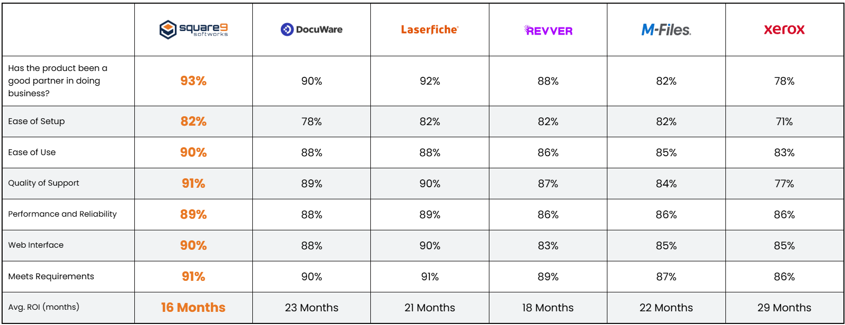
Recognized As The Industry Leader
Notes:
At Square 9, we believe in complete transparency during the evaluation process. We believe there are key differentiators that set us apart and we actively solicit independent reviews to understand what we do well and where we can improve. What you’re seeing here is publicly available at G2, a Gartner company which shows how Square 9 has been rated against our most common competitors.
While it’s great to be rated highest in so many categories, my attention immediately goes to the Average Return on Investment which is rated at 20% our nearest competitors.
Another important differentiator is that as a platform, Square 9 provides and end to end solution for your needs at about the same price as other products that require third party products to achieve the same results. That includes features like true AI driven data extraction and iPaaS integration capabilities for connecting to your line of business applications.

Slide 11
Where We Can Help
Human Resources Automation
1
3
From onboarding to their final day on the job, Square 9 manages the flow of employee information. With web forms to capture critical data and a SOC 2 and HIPAA compliant repository for secure access, we documents their journey every step of the way.
Accounts Payable Automation
Contract Management
2
With AI driven data extraction, Square intelligently handles every task along the AP path including the hands-off generation of an approved bill in your accounting or ERP solution.
It’s time to start digitally, protecting the flow of information where you’re are most vulnerable to risk. Square 9 will ensure you’re working with the correct version while managing expirees and renewals for you automatically.
Notes:
At Square 9 we can digitally transform virtually any business process, whether it’s industry specific or a more generalized practice area.
Hands down, Accounts Payable is where we typically get started. In fact roughly 80% of our new customers start in this area and for good reason. A strong, provable ROI that guarantees a big win for your first project makes it an ideal place to start.
Another favorite is Human Resource Automation where we can transform not only your onboarding process but also you ongoing employee management. With HR departments being asked to do more with less resources, this is a practice area that many companies explore early on.
Finally, contracts management is another high demand area. With document distribution, version control, routing and approval automation and digital signature integration through DocuSign, there is enormous opportunity for process improvement.

Slide 12
Go-To-Market Strategy

Slide 13

Square 9’s Go-To-Market Strategy
Growing Reseller Profitability Requires More Than Just a Strong Product
Unparalleled Pre-Sales and Post Sales Support Programs
In House Professional Services with Delivery Guarantee
Easily adopted Solutions that deliver rapid ROI
Free online education program
Square 9 sets itself apart through a unique level of products, service and support.

Slide 14
Product Review

Slide 15
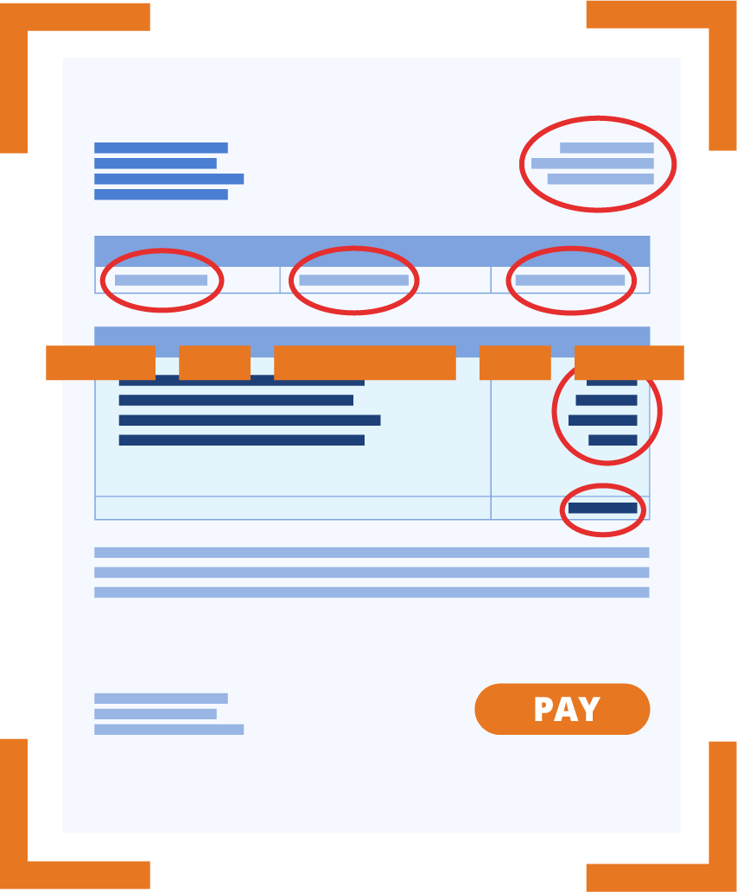
Generative AI Data Extraction
Square 9’s InquireAI eliminates the need for templates from ALL of your documents, bringing unprecedented accuracy, reduced costs, time, and disruptions, and allowing for:
Far less costly implementations
Highly accurate capture for ANY document
Faster and more convenient data validation
Enhanced ROI

Slide 16
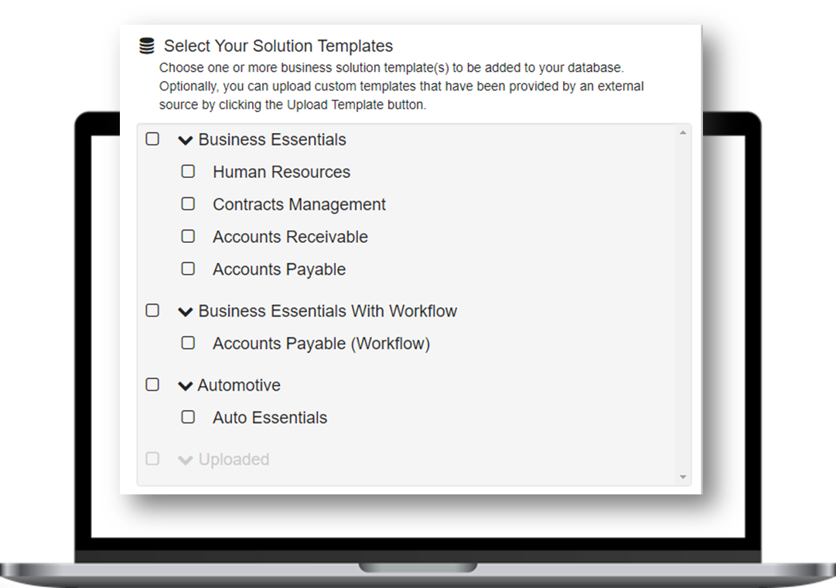
The Solutions Delivery Network
Simplifies the capture, retrieval, organization, and distribution of business information while improving productivity.

Slide 17
Resources

Slide 18
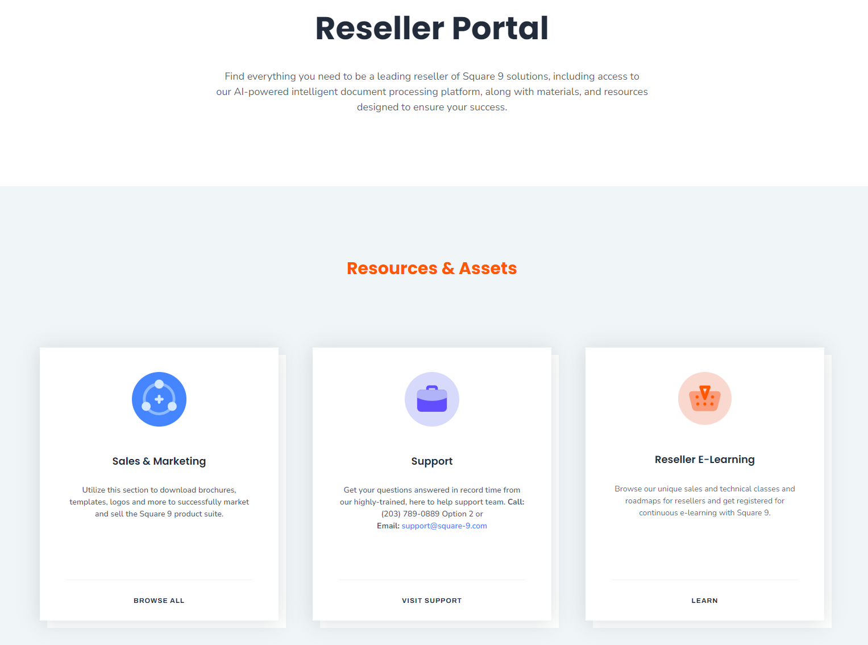
Reseller Portal
Square 9’s Reseller Portal houses a variety of marketing materials including battle cards, brochures, presentations, and proposals to help you drive business growth.

Slide 19
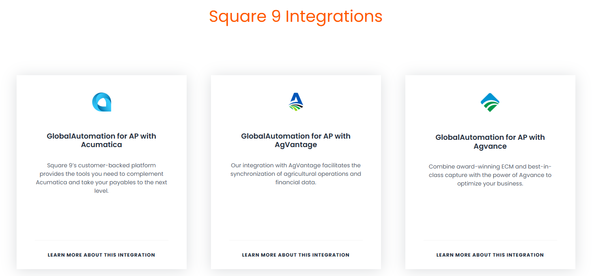
Integrations Page
Square 9 integrates with top business solutions. All these are listed on the integration page with details how our integrations with these platforms help improve your customers’ business processes. Some of Square 9’s integration pages are:
AgVantage
Dynamics 365 Business Central
QuickBooks Online
NetSuite
PDI

Slide 20
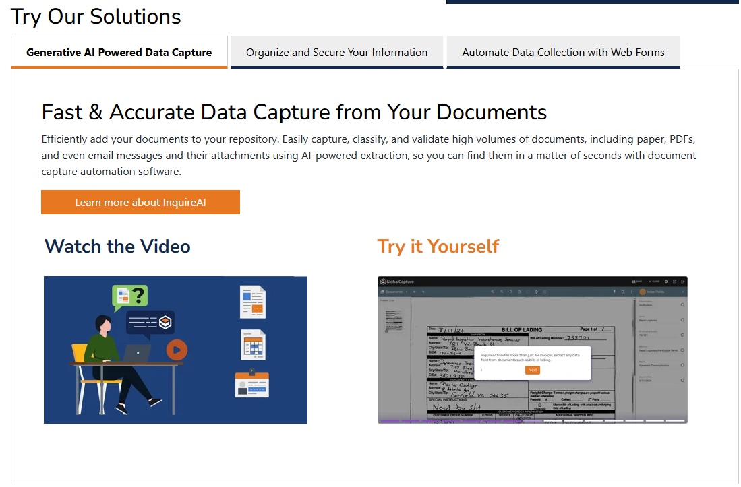
Interactive Demos
Square 9’s Product Library offer free to use guided tours through the Square 9 Platform including:
Document Capture Automation
Enterprise Content Management
Web Forms
Additional demos are geared toward integrations and departments :
GlobalAutomation for AP with MS Dynamics 365 Business Central
GlobalAutomation for AP with QuickBooks
HR Onboarding
Contract Management

Slide 21
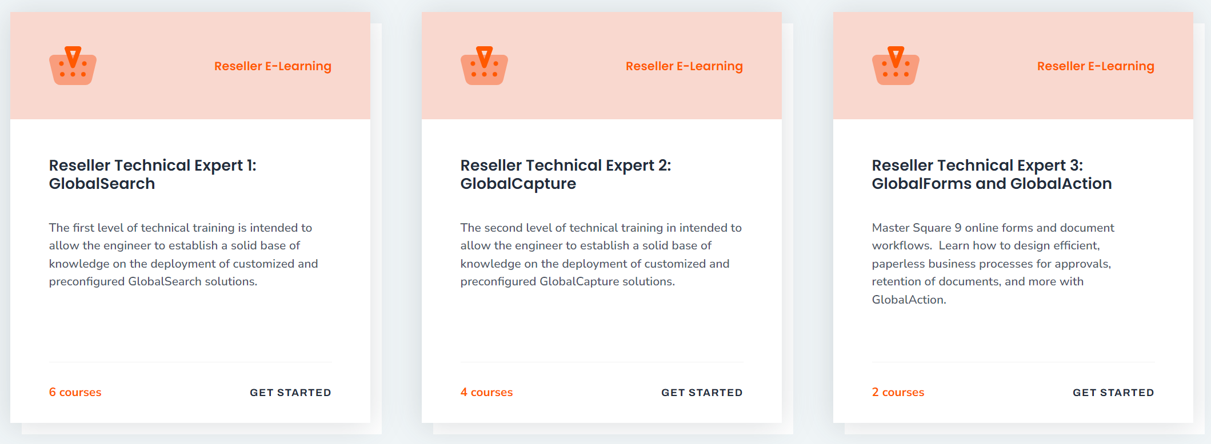
Reseller E-Learning
Customized learning tracks for Reseller Technical Professionals or Sales Professionals will help you learn how to design and manage solutions or uniquely convey the Square 9 platform’s value proposition.

Slide 22
The Reseller Program

Slide 23




Partnering with Square 9
Ensure Project Success. Grow with Confidence.
Annual Recurring Revenue: Grow steady revenue with Square 9’s AI-powered platform.
Sales Team Extension: Leverage our experts across products, industries & departments to drive growth.
In-House Services: Deliver expert setup, support & customization for faster ROI.
Seamless Integration: Connect clients’ systems effortlessly with our iPaaS platform.
Notes:
Annual Recurring Revenue: Build a steady stream with Square 9’s AI-powered Intelligent Information Management Platform
Extension of Your Sales Team: Gain access to our dedicated team of knowledgeable professionals who work with you across products, industries, and departments to support your growth efforts.
In-House Professional Services: Offer Your clients expert assistance with setup, support, and customization with an in-house team of project managers and experience faster ROI on Projects
Onboard iPaaS Integration: Seamlessly integrate your clients’ existing systems for a smooth onboarding process with our own iPaaS platform, which allows you to connect to popular applications like Microsoft Dynamics, and many more.

Slide 24

The 2025 Reseller Program
Three Benefit Levels
Ranging from Limited Commitment to Maximum Return
1. Business Partner
2. Authorized Partner
3. Elite Partner

Slide 25
Objectives
Provide full participation in ARR for all Resellers regardless of their level of commitment
Allow Smaller Resellers to Grow Their ECM Practice Over Time
Eliminate the cost of staffing a support desk for our Resellers by Offering a Direct Support Model
Give Resellers the Opportunity to use Square 9 Products in the Cloud at little or no cost
Empower fully committed resellers with the opportunity to maximize their margins

Slide 26
Business Partner Level
No commitment
No reseller fee
No Minimum Activity Requirement
No Revenue Targets
No Training Requirements
20% On Software and Subscriptions
20% On Professional Services
20% On Subscription Renewals
No Help Desk Responsibilities
All Support Provided by Square 9
Unlimited Access to Demonstration Software

Slide 27
Authorized Partner Level
$3,500 Annual Fee
Earn back 50% of the Annual Fee with 25K in Sales
Earn back 100% of the Annual Fee with 50K in Sales
New Opportunity Minimum of 25 per year
Sales Level I Training Required
No Technical Certification Required
40% on Software and Subscriptions
20% on Professional Services
20% On Subscription Renewals
Partner Provides Level 1 Support
Access Square 9’s entire suite of products at no cost for their internal use.
GlobalSearch Cloud Enterprise Essentials with 15 Named Users
InquireAI (Up to 500 pages per month, volumes over 500 the dealer is required to purchase Production InquireAI)
Unlimited GlobalCapture Volumes
Unlimited GlobalAction Workflows
Unlimited GlobalForms Workflow Licenses
Valued at $15,000/Year

Slide 28
Elite Partner Level
Annual Renewal Fee Waived
Revenue Requirement of $100K per year
New Opportunity Minimum of 40 per year
Minimum Support Deck of 20 Customers
Sales and Technical Training Requirements
Annual Recertification Required
40% on Software and Subscriptions
20% on Professional Services
40% On Subscription Renewals
All Support Provided by Square 9
Access Square 9’s entire suite of products at no cost for their internal use.
GlobalSearch Cloud Enterprise Essentials with 15 Named Users
InquireAI (Up to 500 pages per month, volumes over 500 the dealer is required to purchase Production InquireAI)
Unlimited GlobalCapture Volumes
Unlimited GlobalAction Workflows
Unlimited GlobalForms Workflow Licenses
Valued at $15,000/Year

Slide 29
Questions?

Slide 30





Thank You
203-789-0889
info@square-9.com
www.square-9.com
Book Demo
© 2025 Square 9. All Rights Reserved

